Slide 1
CHAPTER 13
TRANSMITTERS AND RECEIVERS

Slide 2
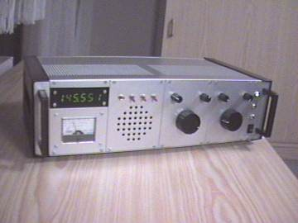
Frequency Modulation (FM) Receiver

Slide 3
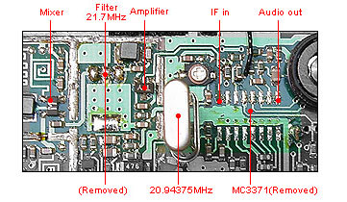
Frequency Modulation (FM) Receiver

Slide 4
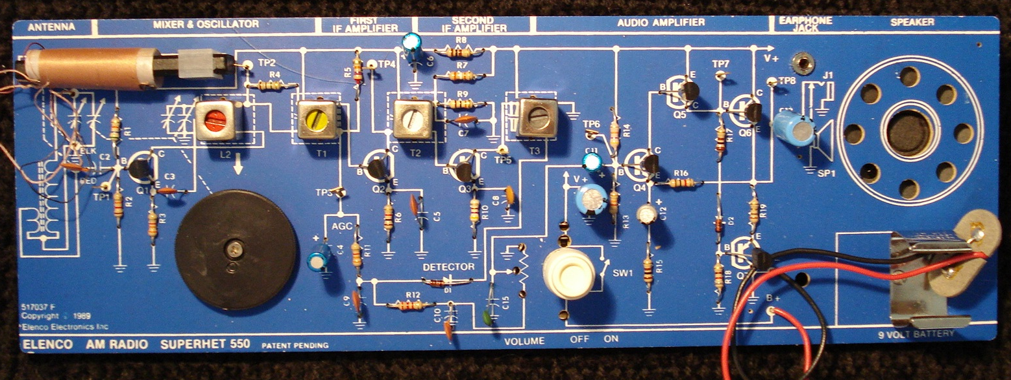
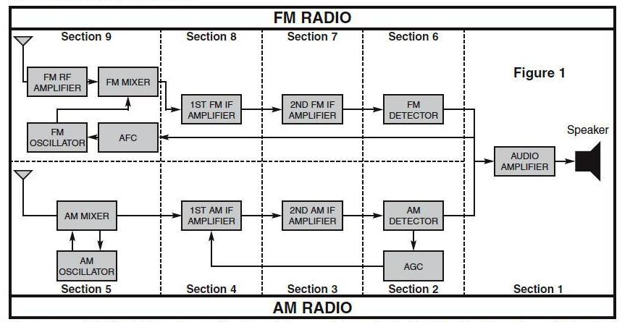
FREQUENCY MODULATION (FM) RECEIVER

Slide 5
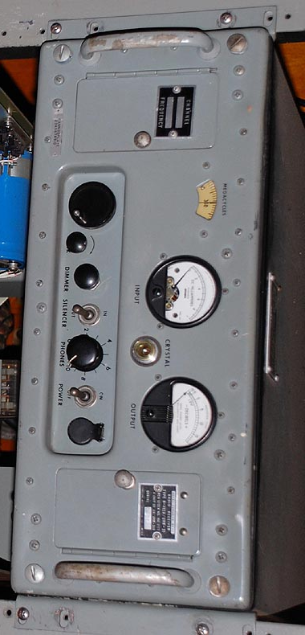
Superheterodyne Receiver

Slide 6
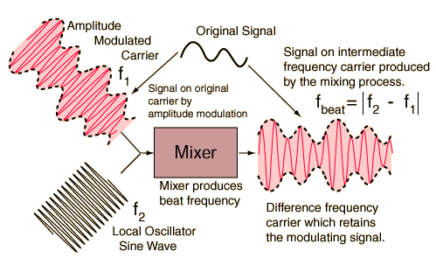
Heterodyning
The word heterodyne is derived from the Greek roots hetero- "different", and -dyne "power".
Heterodyning is the generation of new frequencies by mixing two or more signals in a nonlinear device such as a vacuum tube, transistor, diode mixer.
The mixing of each two frequencies results in the creation of two new frequencies, one at the sum of the two frequencies mixed, and the other at their difference.
A Heterodyne Receiver:
A telecommunication receiver which uses
this effect to produce frequency shifts.

Slide 7
Superheterodyne Receiver
A Superheterodyne Receiver converts any selected incoming frequency by heterodyne action to a preselected common intermediate frequency, for example, 455 kilohertz or 10.7 megahertz, and provides amplification, selectivity, or filtering.
The term heterodyne is sometimes also applied to one of the new frequencies produced by heterodyne signal mixing.
If it were not for heterodyning, you would have to have one receiver for each broadcast station

Slide 8
Superheterodyne Receiver
Incoming radio frequencies from the antenna are made to mix (or multiply) with an internally generated radio frequency from the variable frequency oscillator (VFO) in a process called mixing.
The mixing process can produce a range of output signals:
• the sum of each two mixed frequencies
• the difference between two of the mixed frequencies
• the original frequencies, which are filtered out as they are not wanted.
• harmonics of the above
In very simple radios, it is relatively straightforward to separate this from all the other spurious signals using a filter, to amplify it and then further to process it into an audible signal
In more complex situations, many enhancements and complications get added to this simple process, but this mixing or heterodyning principle remains at the heart of it.

Slide 9
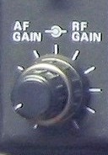
Amplifier Fundamentals
Amplifier is any device that will use a small amount of energy to control a larger amount of energy
The relationship of the input to the output of an amplifier is called the transfer function of the amplifier. The magnitude or size of the transfer function is called the gain.
Gain is a measure of the ability of a circuit to increase the power or amplitude of a signal from the input to the output. It is usually defined as the mean ratio of the signal output of a system to the signal input of the same system. It may also be defined as the decimal logarithm of the same ratio.
(More simply, gain is the ability of an amplifier to increase the
power or amplitude of a signal.)

Slide 10
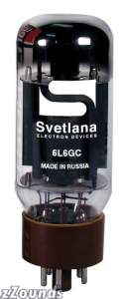
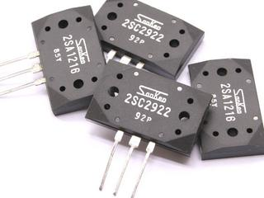
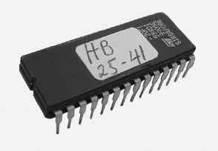
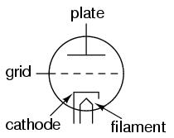
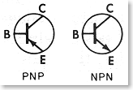

The role of a amplifier is to produce an output which is an enlarged reproduction of the features of the signal fed into the input.
The increase in signal by an amplifier is called gain. We can amplify voltage, current, or power. Resistance IS NOT amplified by a amplifier.
A device with gain has the property of amplification
Vacuum Tube Transistor Integrated Circuit (IC)

Slide 11
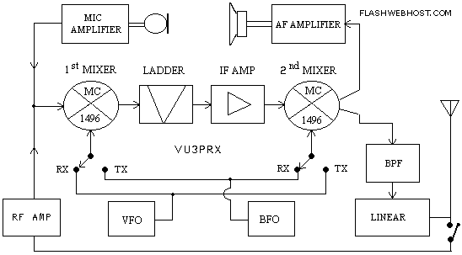
Audio frequency or AF amplifiers are used to amplify AC signals in the audio frequency spectrum, from about 20 Hz to 20 kHz
To increase the level of very weak signals from a microphone you would use a audio (AF) amplifier.

Slide 12
Radio frequency or RF amplifiers are used for signals above 20 kHz. You will encounter both types of amplifiers when you deal with receivers and transmitters.
To increase the level of very weak radio signals from an antenna, you would use a RF amplifier.

Slide 13
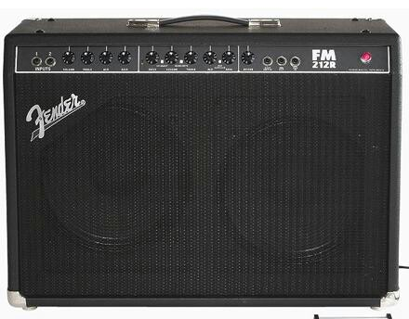
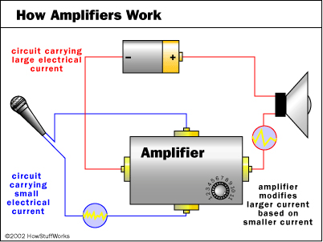
Amplifier

Slide 14
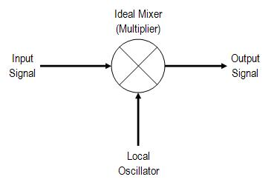
Mixer
Mixer is a nonlinear circuit or device that accepts as its input two different frequencies and presents at its output a mixture of signals at several frequencies:
the sum of the frequencies of the input signals
the difference between the frequencies of the input signals
both original input frequencies — these are often considered parasitic and are filtered out.
The manipulations of frequency performed by a mixer can be used to move signals between bands, or to encode and decode them. One other application of a mixer is as a product detector

Slide 15
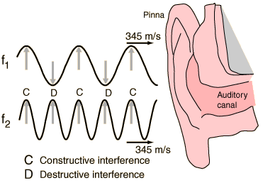

Beat Frequencies
When two sound waves of different frequency approach your ear, the alternating constructive and destructive interference causes the sound to be alternatively soft and loud - a phenomenon which is called "beating" or producing beats.
The beat frequency is equal to the absolute value of the difference in frequency of two waves.

Slide 16
Intermediate Frequency
Intermediate Frequency is the beat frequency between the signal and the local oscillator in a radio detection system
In radios, the intermediate frequency (IF) is the frequency to which a carrier frequency is shifted as an intermediate step in transmission or reception
IF is also the name of a stage in a superheterodyne receiver where an incoming signal is amplified before final detection is done. There may be several such stages in a superheterodyne radio receiver.

Slide 17
Local Oscillator
A local oscillator is a device used to generate a signal which is beat against the signal of interest to mix it to a different frequency
The local oscillator produces a signal which is injected into the mixer along with the signal from the antenna in order to effectively change the antenna signal by heterodyning with it to produce the sum and difference of that signal
One of which will be at the intermediate frequency which can be handled by the IF amplifier

Slide 18
Limiter
A limiter is a circuit that allows signals below a set value to pass unaffected, and clips off the peaks of stronger signals that exceed this set value.
Removes all traces of AM from the received signal
Improves signal-to-noise (S2N) ratio
Reduces static crashes

Slide 19
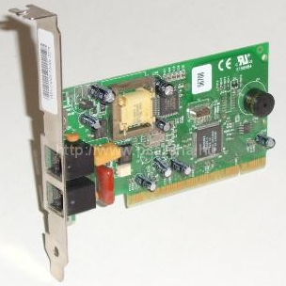
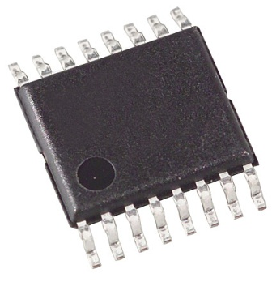
Demodulator
A demodulator is an electronic circuit used to recover the information content from the carrier wave of a signal
The term is usually used in connection with radio receivers, but there are many kinds of demodulators used in many other systems
Another common one is in a modem, which is a contraction of the terms modulator/demodulator

Slide 20
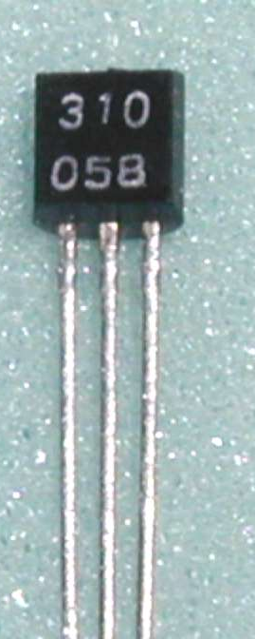
Frequency Discriminator
The frequency discriminator controls the Varicap (variable capacitance diode).
Capacitance is a measure of the amount of electric charge stored
A varicap (an electrically adjustable capacitor) is used to keep the intermediate frequency (IF) stable and:
Gives us a faithful reproduction of the original audio
Converts frequency variations to voltage variation
A diode is a two-terminal device with two active electrodes which a signal of interest may flow. Most are used for their unidirectional electric current property (more on this later).
Varicap diodes, varactor diodes or tuning diodes have variable capacitance.

Slide 21
Frequency Modulation (FM) Receiver
heterodyne action to a pre-selected common intermediate frequency (IF), 455 kilohertz
signal beat against the signal of interest to mix it to a different frequency.
the intermediate frequency (IF) is keep stable.
signals below a set value pass unaffected, and clips off the peaks

Slide 22
There are questions on the block diagrams on transmitters and receivers. See question B-003-003-002 in RIC-7 as an example. There is a summary of these that can be downloaded from the Coax Publications web site. It is an EXCEL file named Cheat Sheet.

