Slide 1
CHAPTER 9
Actives Devices: Diodes, Transistors, Tubes

Slide 2
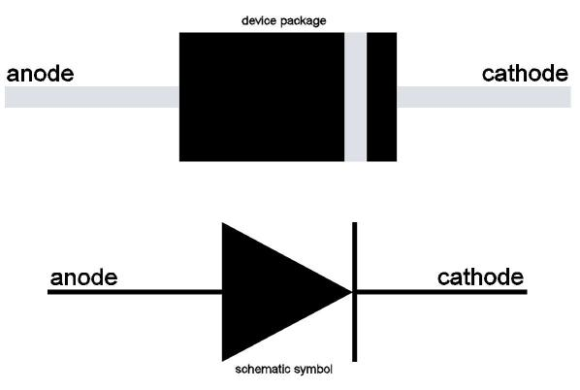
Diode Fundamentals
The electrodes of a semiconductor diode are known as anode and cathode.
In a semiconductor diode, electrons flow from cathode to anode. In order for a diode to conduct, it must be forward-biased.

Slide 3
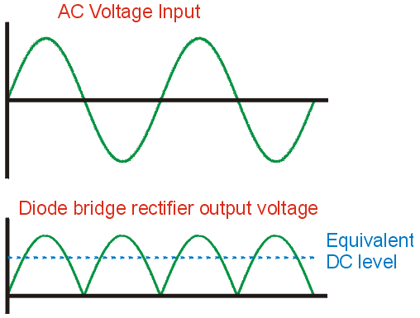
Diode Fundamentals
If alternating current is applied to the anode of a diode, at the cathode of the diode you would expect to see pulsating direct current
The action of changing alternating current (AC) to direct current (DC) is called rectification

Slide 4
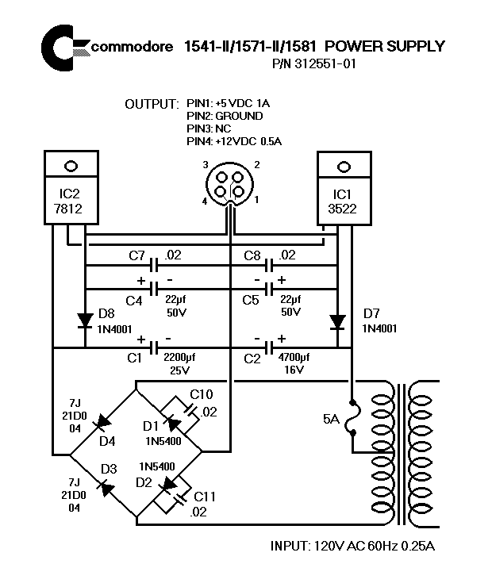
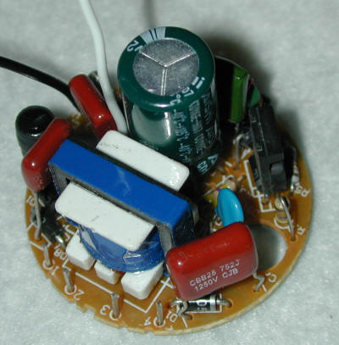
Diode Fundamentals

Slide 5
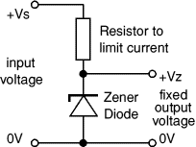

Diode Fundamentals
Zener diodes are used to maintain a fixed voltage. They are designed to 'breakdown' in a reliable and non-destructive way so that they can be used in reverse to maintain a fixed voltage across their terminals. The diagram shows how they are connected, with a resistor in series to limit the current.

Slide 6
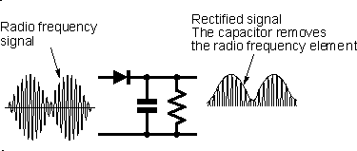
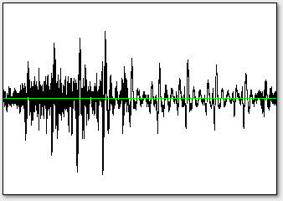
Diode Fundamentals
One important application for diodes is recovering information from transmitted signals. This is referred to as demodulation.
The AM detector or demodulator includes a capacitor at the output. Its purpose is to remove any radio frequency components of the signal at the output.
Audio Signal

Slide 7
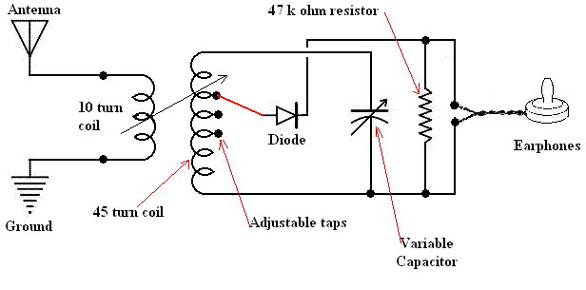
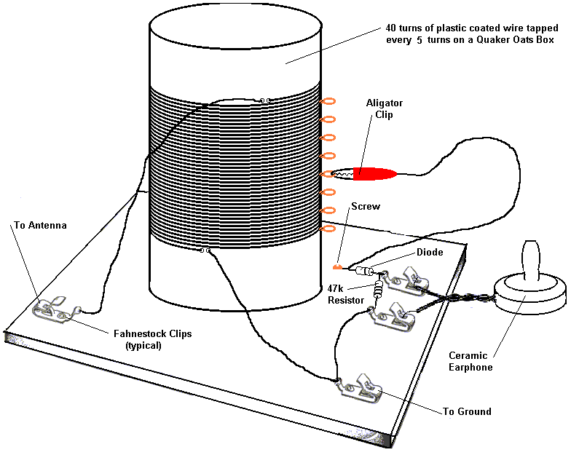
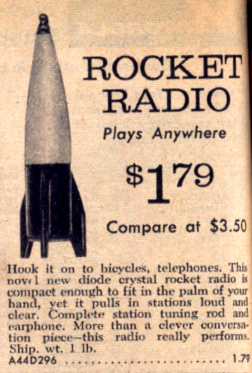
Diode Fundamentals
4.2 Diode Fundamentals

Slide 8
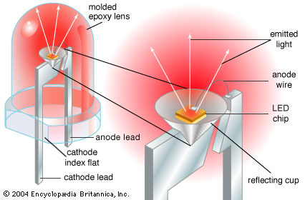
Diode Fundamentals
Light Emitting Diodes (LEDs) are solid-state semiconductor devices that convert electrical energy directly into light.
LED "cold" generation of light is highly efficient because most of the energy radiates within the visible spectrum.
Because LEDs are solid-state devices, they can be extremely small and durable; they also provide longer lamp life than other sources.
LEDs are made of various semiconducting compounds, depending on the desired colour output. Infrared and red LEDs generally use a gallium, aluminum, and arsenide compound. Orange and yellow LEDs most often use gallium, aluminum, and either indium or phosphorus. Green and blue LEDs typically use either silicon and carbon, or gallium and nitrogen.

Slide 9
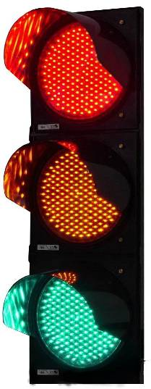


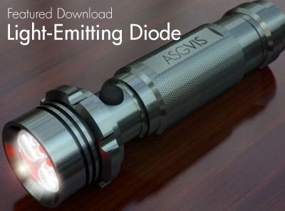
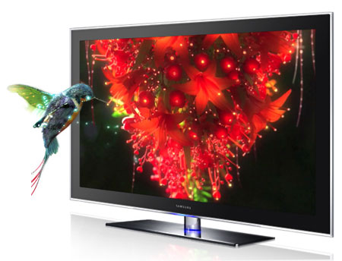


Diode Fundamentals
Light Emitting Diodes (LEDs)

Slide 10
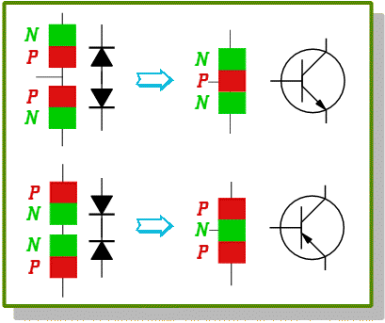
Bipolar Transistor Fundamentals
The basic semiconductor amplifying device is the transistor
A Bipolar Transistor essentially consists of a pair of PN Junction Diodes that are joined back-to-back.
This forms a sort of a sandwich where one kind of semiconductor is placed in between two others.
There are therefore two kinds of Bipolar sandwich, the NPN and PNP varieties. The three layers of the sandwich are conventionally called the Collector, Base, and Emitter.

Slide 11
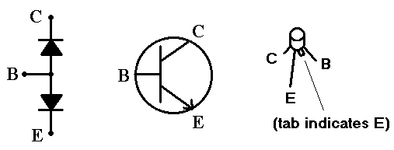
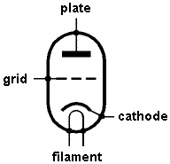
Bipolar Transistor Fundamentals
In a bipolar transistor the base compares closest to the control grid of a triode vacuum tube
In a bipolar transistor the collector compares closest to the plate of a triode vacuum tube
In a bipolar transistor the emitter compares closest to the cathode of a triode vacuum tube

Slide 12
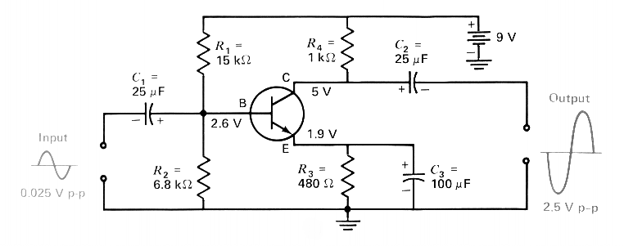
Bipolar Transistor Fundamentals
A PNP transistor can amplify a small signal using low voltages. If a low level signal is placed at the input to a transistor, a higher level of signal is produced at the output lead. This effect is known as amplification

Slide 13
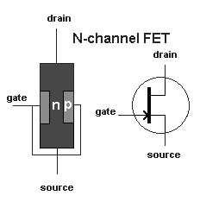
Field Effect Transistor (FET) Fundamentals
A field effect transistor has only two layers of semiconductor material, one on top of the other. Electricity flows through one of the layers, called the channel. A voltage connected to the other layer, called the gate, interferes with the current flowing in the channel. Thus, the voltage connected to the gate controls the strength of the current in the channel.
There are two basic varieties of field effect transistors - the junction field effect transistor (JFET) and the metal oxide semiconductor field effect transistor (MOSFET).
In a field effect transistor, the gate controls the conductance of the channel, the source is where the charge carriers enter the channel and the drain is where the charge carriers leave the channel.
The control element in a field effect transistor is the gate.

Slide 14
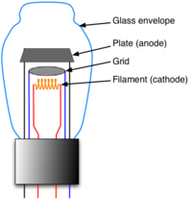
Triode Vacuum Tube Fundamentals
A vacuum tube consists of arrangements of electrodes in a vacuum within an insulating, temperature-resistant envelope.
The electrodes are attached to leads which pass through the envelope via an air tight seal.
When hot, the filament releases electrons into the vacuum: a process called thermionic emission.
The resulting negatively-charged cloud of electrons is called a space charge. These electrons will be drawn to a metal plate inside the envelope, if the plate (also called the anode) is positively charged relative to the filament (or cathode). The result is a flow of electrons from filament to plate.

Slide 15
Triode Vacuum Tube Fundamentals
Vacuum Tube versus Transistor
- triode vacuum tube can be used instead of a transistor to handle higher power
vacuum tube can amplify small signals but must use high voltages
both tubes and transistors can amplify signals
In a vacuum tube:
the electrode that is operated at the highest positive potential is the plate
the electrode that is usually a cylinder of wire mesh is the grid
the electrode that is farthest away from the plate is the filament
the electrode that emits electrons is the cathode
.

