Slide 1
CHAPTER 8
ANTENNAS

Slide 2
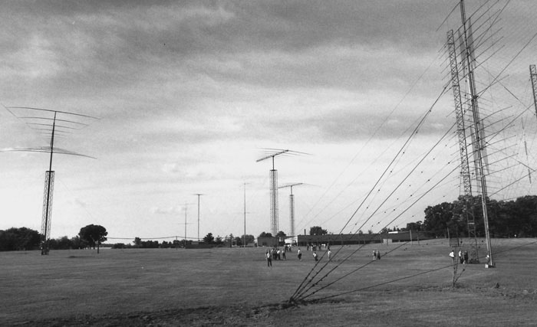

Slide 3
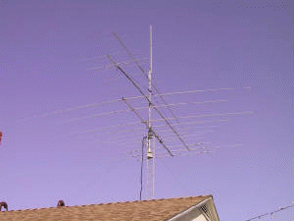
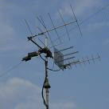


Antennas
A good antenna works
A bad antenna is a waste of time & money
Antenna systems can be very inexpensive and simple
They can also be very, very expensive

Slide 4
Antenna Considerations
The space available for an antenna
The proximity to neighbours
The operating frequencies you will use
The output power
Money

Slide 5
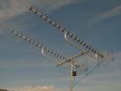


Antenna Types
High Frequency
1.6 - 30 MHz + 50 MHz
160 - 6 metres
An antenna’s size/length depends on the frequency
It’s functionality largely depends on the height above ground, as well as the polarity and it’s configuration

Slide 6
Some Math
Velocity of propagation 300,000,000 m/sec
For 1 wavelength, above 30 MHz
The length of a half wave dipole for 3.65 MHz
Frequency (f) = 300 / wavelength
Wavelength (λ) = 300 / frequency
Frequency measured in megahertz
Wavelength measured in meters
Above 30 MHz, λ = 300/f metres or 984/f feet
For a half wave λ = 150/f metres or 492/f feet
Below 30 MHz λ = 286/f metres or 936/f feet (including the velocity factor 0f 0.95)
For a half wave λ = 143/f metres or 468/f feet
The length of a half wave dipole for 3.65 MHz
L = 143/f = 143/3.65 = 39.18 metres
The higher the frequency the shorter the antenna
The lower the frequency the longer the antenna

Slide 7
Types of Antennas
Simple wire
Dipole
Folded dipole
Trap dipole
Offset or Windom antenna
Phased dipoles
Vertical or horizontal (both)
Beverage wave antenna

Slide 8
Types of Antennas
Metal
Vertical
Yagi
Trap Yagi
Phased arrays
Loops
Vertical or Horizontal
Horns for super ultra high frequencies
Mobile antennas

Slide 9
Antenna Polarization
Vertical or horizontal
Electrical vs Magnetic radiation
(Diagram)
Vertical waves travel @ 90◦ to the earths surface
Horizontal waves travel parallel to the earth’s surface
Usually wire antennas are horizontal but an inverted ‘V’ dipole has a vertical component
Yagi type antennas can be either vertical or horizontal
Circular antennas can be both
Usually, horizontally polarized antennas hear less noise

Slide 10
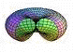

Isotropic Antenna
The isotropic antenna is a hypothetical point source.
It does not exist in reality but is considered as an important starting point considering different
antennas from the theoretical to the practical
The pattern is a Cardioid - a donut shape or a sphere
Dipole Radiation
Pattern

Slide 11
Polarization - Practical
Antennas radiating a vertical polarization are best received by an antenna of like polarization
Cross polarization reduces reception by as much as 30 db
Bouncing DX signals probably have both polarizations
Designing antenna polarization usually depends on the frequency being used - at 70 cm in the UHF band the elements are very short so either polarization is possible. Usually vertical is used as repeaters are vertically polarized.

Slide 12
Resonance
Antenna length is dependent on frequency
The lower the frequency the longer the antenna elements
Examples
80 metres 3.750 MHz 124 ft.
40 7.055 66
10 28.5 16.4
6 52 9
2 145 3.2

Slide 13
Isotropic Source
Polarization by Element Orientation Page 48 / 9
An isotropic antenna is a: hypothetical point source
What is the antenna radiation pattern for an isotropic radiator? A sphere
Polarization of an antenna is determined by: the electric field
What does horizontal wave polarization mean? The electric lines of force of a radio wave are parallel to the earth's surface
What does vertical wave polarization mean? The electric lines of force of a radio wave are perpendicular to the earth's surface

Slide 14
Polarization by Element Orientation Con’t
What electromagnetic wave polarization does a Yagi antenna have when its elements are parallel to the earth's surface? Horizontal
What electromagnetic wave polarization does a half-wavelength antenna have when it is perpendicular to the earth's surface? Vertical
VHF signals from a mobile station using a vertical whip antenna will normally be best received using a: vertical ground-plane antenna
A dipole antenna will emit a vertically polarized wave if it is: Parallel with the ground mounted vertically
If an electromagnetic wave leaves an antenna vertically polarized, it will arrive at the receiving antenna, by ground wave: vertically polarized
Compared with a horizontal antenna, a vertical antenna will receive a vertically polarized radio wave: at greater strength

Slide 15
Wavelength vs Physical Length Page 49
The speed of a radio wave: is the same as the speed of light
The velocity of propagation of radio frequency energy in free space is: 300 000 kilometres per second
If an antenna is made longer, what happens to its resonant frequency? It decreases
If an antenna is made shorter, what happens to its resonant frequency? It increases
The resonant frequency of an antenna may be increased by: shortening the radiating element

Slide 16
Wavelength vs Physical Length Con’t
To lower the resonant frequency of an antenna, the operator should: lengthen it
Adding a series inductance to an antenna would:
decrease the resonant frequency

Slide 17
Wavelength vs Physical Length Con’t
The wavelength for a frequency of 25 MHz is:
12 metres (39.4 ft.)
The wavelength corresponding to a frequency of 2 MHz is: 150 m (492 ft.)
  At the end of suspended antenna wire, insulators are used. These act to: limit the electrical length of the antenna
  One solution to multi-band operation with a shortened radiator is the "trap dipole" or trap vertical. These "traps" are actually: a coil and capacitor in parallel

Slide 18
Gain, Directivity, etc. Page 50
What is meant by antenna gain? The numerical ratio relating the radiated signal strength of an antenna to that of another antenna
The gain of an antenna, especially on VHF and above, is quoted in dBi. The "i" in this expression stands for: isotropic
Approximately how much gain does a half-wave dipole have over an isotropic radiator? 2.1 dB
What is a parasitic beam antenna? An antenna where some elements obtain their radio energy by induction or radiation from a driven element
If a slightly shorter parasitic element is placed 0.1 wavelength away from an HF dipole antenna, what effect will this have on the antenna's radiation pattern? A major lobe will develop in the horizontal plane, toward the parasitic element
If a slightly longer parasitic element is placed 0.1 wavelength away from an HF dipole antenna, what effect will this have on the antenna's radiation pattern? A major lobe will develop in the horizontal plane, away from the parasitic element, toward the dipole

Slide 19
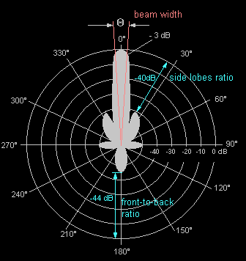
Gain, Directivity, etc. Con’t
In free space, what is the radiation characteristic of a half-wave dipole? Minimum radiation from the ends, maximum broadside
The front-to-back ratio of a beam antenna is: the ratio of the maximum forward power in the major lobe to the maximum backward power radiation
The property of an antenna, which defines the range of frequencies to which it will respond, is called its: bandwidth
What is meant by antenna bandwidth? The frequency range over which the antenna may be expected to perform well
How can the bandwidth of a parasitic beam antenna be increased? Use larger diameter elements

Slide 20
Vertical Antennae Page 50
To calculate the length in metres (feet) of a quarter wave vertical antenna you would : Divide 71.5 (234) by the antenna's operating frequency (in MHz)
If you made a quarter-wavelength vertical antenna for 21.125 MHz, how long would it be? 3.6 metres (11.8 ft.)
If you made a half-wavelength vertical antenna for 223 MHz, how long would it be? 64 cm (25.2 in)
If a magnetic-base whip antenna is placed on the roof of a car, in what direction does it send out radio energy? It goes out equally well in all horizontal directions
What is an advantage of downward sloping radials on a ground plane antenna? It brings the feed point impedance closer to 50 ohms

Slide 21

Vertical Antennae Con’t
What happens to the feed point impedance of a ground-plane antenna when its radials are changed from horizontal to downward-sloping? It increases
Which of the following transmission lines will give the best match to the base of a quarter-wave ground-plane antenna? 50 ohms coaxial cable
The main characteristic of a vertical antenna is that it will: receive signals equally well from all compass points around it
Why is a loading coil often used with an HF mobile vertical antenna? To tune out capacitive reactance
What is the main reason why so many VHF base and mobile antennas are 5/8 of a wavelength? The angle of radiation is low
Why is a 5/8-wavelength vertical antenna better than a 1/4-wavelength vertical antenna for VHF or UHF mobile operations? A 5/8-wavelength antenna has more gain

Slide 22
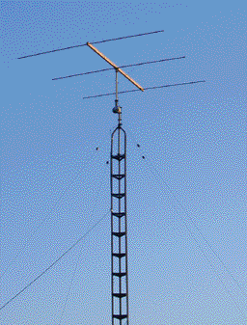
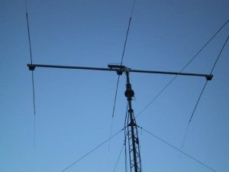
Yagi-Uda Three-Element
Directional Antenna

Slide 23
Yagi-Uda Three-Element
Directional Antenna

Slide 24
Yagi Antennae Page 51
How many directly driven elements do most Yagi antennas have? One
Approximately how long is the driven element of a Yagi antenna for 14.0 MHz? 10.21 metres (33 feet and 6 inches)
Approximately how long is the director element of a Yagi antenna for 21.1 MHz? 6.4 metres (21 feet)
Approximately how long is the reflector element of a Yagi antenna for 28.1 MHz? 5.33 metres (17.5 feet long)
The spacing between the elements on a three-element Yagi antenna, representing the best overall choice, is : 0.2 of a wavelength.
What is one effect of increasing the boom length and adding directors to a Yagi antenna? Gain increases
What are some advantages of a Yagi with wide element spacing? High gain, less critical tuning and wider bandwidth

Slide 25
Yagi Antennae Con’t
What are some advantages of a Yagi with wide element spacing? High gain, less critical tuning and wider bandwidth
Why is a Yagi antenna often used for radiocommunications on the 20-metre band? It helps reduce interference from other stations off to the side or behind
What does "antenna front-to- back ratio" mean in reference to a Yagi antenna? The power radiated in the major radiation lobe compared to the power radiated in exactly the opposite direction
What is a good way to get maximum performance from a Yagi antenna? Optimize the lengths and spacing of the elements
If the forward gain of a six- element Yagi is about 10 dB, what would the gain of two of these antennas be if they were "stacked"? 13 dB

Slide 26
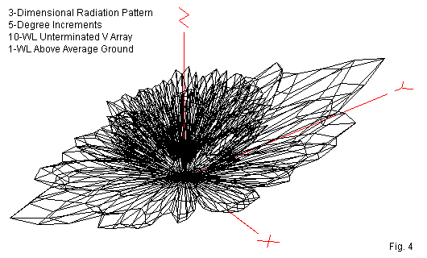


Wire Antennae Page 51 / 52
If you made a half-wavelength dipole antenna for 28.550 MHz, how long would it be? 5.08 metres (16.62 ft.)
What is the low angle radiation pattern of an ideal half-wavelength dipole HF antenna installed parallel to the earth? It is a figure-eight, perpendicular to the antenna
The impedances in ohms at the feed point of the dipole and folded dipole are, respectively: 73 and 300

Slide 27
Wire Antennae Con’t
A dipole transmitting antenna, placed so that the ends are pointing North/South, radiates: mostly to the East and West
How does the bandwidth of a folded dipole antenna compare with that of a simple dipole antenna? It is greater
What is a disadvantage of using an antenna equipped with traps? It will radiate harmonics
What is an advantage of using a trap antenna?
It may be used for multi- band operation
What is one disadvantage of a random wire antenna? You may experience RF feedback in your station

Slide 28
Quad / Loop antennae Page 52
What is a cubical quad antenna? Two or more parallel four- sided wire loops, each approximately one-electrical wavelength long
What is a delta loop antenna? A type of cubical quad antenna, except with triangular elements rather than square
The cubical "quad" or "quad" antenna consists of two or more square loops of wire. The driven element has an approximate overall length of: one wavelength
The delta loop antenna consists of two or more triangular structures mounted on a boom. The overall length of the driven element is approximately: one wavelength
Approximately how long is each side of a cubical quad antenna driven element for 21.4 MHz? 3.54 metres (11.7 feet)
Approximately how long is each side of a cubical quad antenna driven element for 14.3 MHz? 5.36 metres (17.6 feet)
Approximately how long is each leg of a symmetrical delta loop antenna driven element for 28.7 MHz? 3.5 metres (11.5 feet)

Slide 29
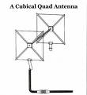
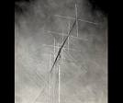


Quad / Loops Con’t
Which statement about two- element delta loops and quad antennas is true? They compare favorably with a three element Yagi
Compared to a dipole antenna, what are the directional radiation characteristics of a cubical quad antenna? The quad has more directivity in both horizontal and vertical planes
Moving the feed point of a multi-element quad antenna from a side parallel to the ground to a side perpendicular to the ground will have what effect? It will change the antenna polarization from horizontal to vertical
What does the term "antenna front-to back ratio" mean in reference to a delta loop antenna? The power radiated in the major radiation lobe compared to the power radiated in exactly the opposite direction

Slide 30
