Slide 1
CHAPTER 7
TRANSMISSION LINES a.k.a. FEEDLINES

Slide 2
Perfect Feedline (ya, really)
A perfect feedline will have:
No radiation from the feedline itself
No loss of signal while passing along the line
Constant electrical characteristics throughout Such a feedline will pass 100% of the RF energy through it.
NOTE: This situation does not ever exist! (yet)!!

Slide 3
Feedline (transmission line)
2 CONDUCTORS
Capacitance because of 2 parallel lines (plates) Inductance because of the length of the lines and their proximity to each other.
Resistance in the metal itself slowing the flow
Therefore a feedline is a circuit which has reactance to the passage of AC current and which varies inversely as the operating frequency which means the value stays approximately the same over any given length. This value is called the characteristic impedance of the circuit. (Z_{o})
At HF frequencies, the signal passes through the conductor while at frequencies above 10 MHz, the signal passes along the surface, or skin of the wire. This is known as ‘skin effect’ where the losses increase with the frequency

Slide 4

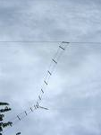
Balanced feedlines
Open wire feedlines
Characteristic impedance of 200 – 600 Ω depending on the diameter of the wire and the distance between them.
Z_{o}= 276 log 2(S/D) S=Distance between and D=diameter

Slide 5
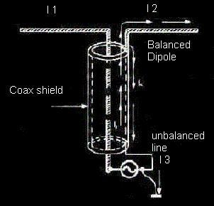
Unbalanced feedlines
One side to ground
Other side carries
RF to antenna
Coaxial cable is waterproof
Hardline or Heliax is best for VHF/UHF and up (Heliax uses copper not braid for the shield)
– hard to bend -
Z_{o}=138/√e log D/d
e=dielectric constant
D=diameter of the outer conductor
D=diameter of the inner conductor

Slide 6
Feed Lines
Feedlines connect a radio to an antenna
They must be matched to the radio system - they should have like impedance
Radios usually have a 50 ohm output
Antenna feedpoints have a very wide impedance range
Velocity factor .66 - .95

Slide 7
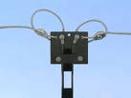

Feed Lines Con’t
Feed lines can be easily made
The two favourite for amateur radio are the coaxial cable and open wire feedlines

Slide 8
Feed Line Questions See Page 45
What connects your transceiver to your antenna?
Feed Line
What kind of feed line can be buried in the ground for some distance without adverse effects? Coaxial Cable
A transmission line differ from an ordinary circuit or network in communications or signal devices in one important way. That important way is Propagation Delay

Slide 9
Feed Line Questions Con’t
The characteristics of a transmission line is determined by the
Physical dimensions and relative positions of the conductors
The characteristics of a transmission line is equal to the Pure Resistance which, if connected to the end of the line, will absorb all the power arriving along it
Think of the paper towel absorption advertisement
The characteristic impedance of a coaxial antenna feed line is determined by the Ratio of the diameter of the inner conductor to the diameter of the braid

Slide 10
Feed Line Questions Con’t
The characteristic impedance of a parallel wire transmission line does not depend on the velocity of energy on the line
What factors determine the characteristic impedance of a parallel-conductor antenna feed line? The distance between the centres of the conductors and the radius of the conductors
Any length of transmission line may be made to appear as an infinitely long line by: Terminating the line in its characteristic impedance
The characteristic impedance of a 20 metre piece of transmission line is 52 ohms

Slide 11
Feed Line Questions Con’t
The impedance of a coaxial line:
can be the same for different diameter line

Slide 12
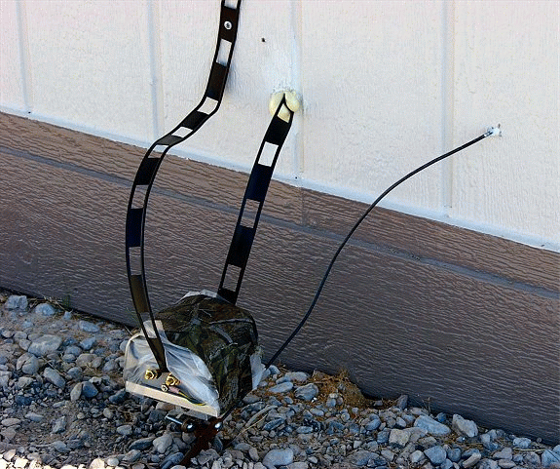
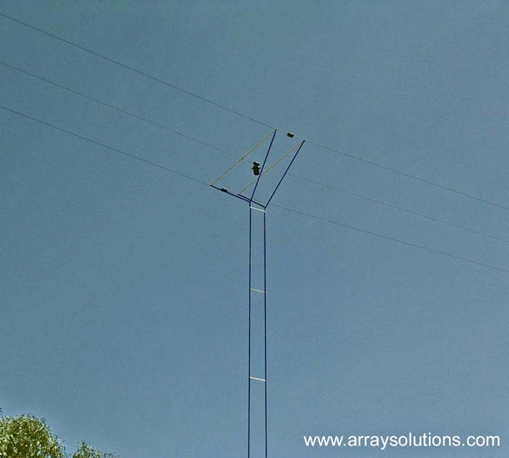
Balanced & Unbalanced Feed Lines
A balanced transmission line: is made of two parallel wires
What is parallel-conductor feed line? Two wires side-by-side held apart by insulating rods
What kind of antenna feed line is made of two conductors held apart by insulated rods? Open-conductor ladder line
What kind of antenna feed line can be constructed using two conductors which are maintained a uniform distance apart using insulated spreaders? 600 ohm open-wire

Slide 13
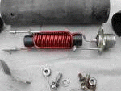
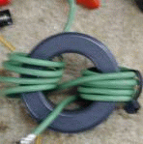
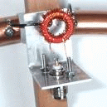

Balanced & Unbalanced Feed Lines - 2
What is an unbalanced line? Feed line with one conductor connected to ground
What is a coaxial cable? A center wire inside an insulating material which is covered by a metal sleeve or shield
A flexible coaxial line contains: Braid and insulation around a central conductor
What device can be installed to feed a balanced antenna with an unbalanced feed line? A balun
What does the term "balun" mean? Balanced to unbalanced

Slide 14
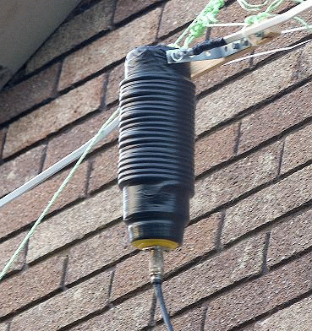
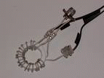
Balanced & Unbalanced Feed Lines - 3
Where would you install a balun to feed a dipole antenna with 50-ohm coaxial cable? Between the coaxial cable and the antenna
A 75 ohm transmission line could be matched to the 300 ohm feed point of an antenna: by using a 4 to 1 balun

Slide 15
Popular Antenna Feed Lines Page 46
Why does coaxial cable make a good antenna feed line? It is weatherproof, and its impedance is higher than that of most amateur antennas
What is the best antenna feed line to use, if it must be put near grounded metal objects? Coaxial cable
What commonly available antenna feed line can be buried directly in the ground for some distance without adverse effects? Coaxial cable
If you install a 6 metre Yagi antenna on a tower 50 metres from your transmitter, which of the following feed lines is best? RG-213
What are some reasons not to use parallel-conductor feed line? It does not work well when tied down to metal objects, and you must use an impedance-matching device with your transceiver
TV twin-lead feed line can be used for a feed line in an amateur station. The impedance of this line is approximately: 300 ohms

Slide 16
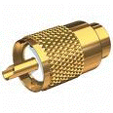
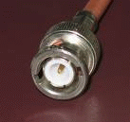

Connectors
What common connector usually joins RG-213 coaxial cable to an HF transceiver? A PL-259 connector
What common connector usually joins a hand-held transceiver to its antenna? A BNC connector
Which of these common connectors has the lowest loss at UHF? A type-N connector
Why should you regularly clean, tighten and re-solder all antenna connectors? To help keep their resistance at a minimum

Slide 17
Line Losses Page 47
Why should you use only good quality coaxial cable and connectors for a UHF antenna system? To keep RF loss low
In what values are RF feed line losses expressed?
dB per unit length
Losses occurring on a transmission line between transmitter and antenna results in: less RF power being radiated
If the length of coaxial feed line is increased from 20 metres (65.6 ft.) to 40 metres (131.2 ft.), how would this affect the line loss? It would be increased by 100%
What are some reasons to use parallel conductor feed line? It will operate with a high SWR, and has less loss than coaxial cable

Slide 18
Line Losses Con’t
If your transmitter and antenna are 15 metres apart, but are connected by 65 metres of RG-58 coaxial cable, what should be done to reduce feed line loss? Shorten the excess cable
The lowest loss feed line on HF is: 300 ohm twin- lead
As the length of a feed line is changed, what happens to signal loss? Signal loss increases as length increases
As the frequency of a signal is changed, what happens to signal loss in a feed line? Signal loss increases with increasing frequency

Slide 19
Standing Waves Page 47
If the characteristic impedance of the feedline does not match the antenna input impedance then: standing waves are produced in the feedline
The result of the presence of standing waves on a transmission line is: reduced transfer of RF energy to the antenna
What does the standing wave ration means? ratio of maximum to minimum voltages on a feed line
What does an SWR reading of 1:1 mean?
The best impedance match has been attained
What does an SWR reading of less than 1.5:1 mean? A fairly good impedance match
A resonant antenna having a feed point impedance of 200 ohms is connected to a feed line and transmitter which have an impedance of 50 ohms. What will the standing wave ratio of this system be? 4:1
What kind of SWR reading may mean poor electrical contact between parts of an antenna system? A jumpy reading

Slide 20
Standing Waves Con’t
What does a very high SWR mean? The antenna is the wrong length, or there may be an open or shorted connection somewhere in the feed line
If your antenna feed line gets hot when you are transmitting, what might this mean? The SWR may be too high, or the feed line loss may be high
The type of feed line best suited to operating at a high standing wave ratio is: 600 ohm open-wire
SWR meter measures the degree of match between transmission line and antenna by: comparing forward and reflected voltage

Slide 21

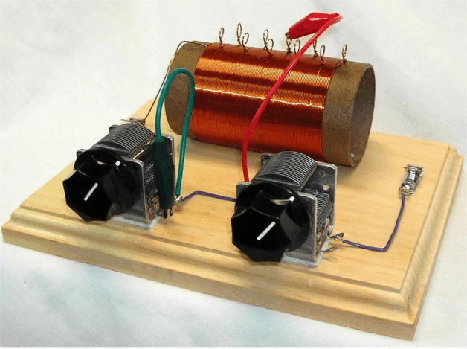

Impedance Matching Page 48
What device might allow use of an antenna on a band it was not designed for? An antenna tuner
What does an antenna matching unit do? It matches a transceiver to a mismatched antenna system
What would you use to connect a coaxial cable of 50 ohms impedance to an antenna of 35 ohms impedance? An impedance-matching device
When will a power source deliver maximum output to the load? When the impedance of the load is equal to the impedance of the source

Slide 22
Impedance Matching Page 48
What happens when the impedance of an electrical load is equal to the internal impedance of the power source? The source delivers maximum power to the load
Why is impedance matching important? So the source can deliver maximum power to the load
To obtain efficient power transmission from a transmitter to an antenna requires: matching of impedances
If an antenna is correctly matched to a transmitter, the length of transmission line: will have no effect on the matching
If the centre impedance of a folded dipole is approximately 300 ohms, and you are using RG8U (50 ohms) coaxial lines, what is the ratio required to have the line and the antenna matched? 6:1

Slide 23
Impedance ( A reading for interest only. This will NOT appear on the exam!)
DEFINITIONS
Impedance, denoted Z, is an expression of the opposition that an electronic component, circuit, or system offers to alternating and/or direct electric current. Impedance is a vector (two-dimensional)quantity consisting of two independent scalar (one-dimensional) phenomena: resistance and reactance.
Resistance, denoted R, is a measure of the extent to which a substance opposes the movement of electrons among its atoms. The more easily the atoms give up and/or accept electrons, the lower the resistance, which is expressed in positive real number ohms. Resistance is observed with alternating current (AC) and also with direct current (DC). Examples of materials with low resistance, known as electrical conductors, include copper, silver, and gold. High-resistance substances are called insulators or dielectrics, and include materials such as polyethylene, mica, and glass. A material with an intermediate levels of resistance is classified as a semiconductor. Examples are silicon, germanium, and gallium arsenide.
Reactance, denoted X, is an expression of the extent to which an electronic component, circuit, or system stores and releases energy as the current and voltage fluctuate with each AC cycle. Reactance is expressed in imaginary number of ohms. It is observed for AC, but not for DC. When AC passes through a component that contains reactance, energy might be stored and released in the form of a magnetic field, in which case the reactance is inductive (denoted +jXL); or energy might be stored and released in the form of an electric field, in which case the reactance is capacitive (denoted -jXC). Reactance is conventionally multiplied by the positive square root of -1, which is the unit imaginary number called the j operator, to express Z as a complex number of the form R + jXL (when the net reactance is inductive) or R - jXC (when the net reactance is capacitive).
The illustration shows a coordinate plane modified to denote complex-number impedances. Resistance appears on the horizontal axis, moving toward the right.(The left-hand half of this coordinate plane is not normally used because negative resistances are not encountered in common practice.)Inductive reactance appears on the positive imaginary axis, moving upward. Capacitive reactance is depicted on the negative imaginary axis, moving downward. As an example, a complex impedance consisting of 4 ohms of resistance and +j5 ohms of inductive reactance is denoted as a vector from the origin to the point on the plane corresponding to 4 + j5.

Slide 24
Impedance
In series circuits, resistances and reactances add together independently. Suppose a resistance of 100.00 ohms is connected in a series circuit with an inductance of 10.000 μH. At 4.0000 MHz, the complex impedance is:
ZRL = R + jXL = 100.00 + j251.33
If a capacitor of 0.0010000 μF is put in place of the inductor, the resulting complex impedance at 4.0000 MHz is:
ZRC = R - jXC = 100.00 - j39.789
If all three components are connected in series, then the reactances add, yielding a complex impedance of:
ZRLC = 100 + j251.33 - j39.789 = 100 + j211.5
This is the equivalent of a 100-ohm resistor in series with an inductor having +j211.5 ohms of reactance. At 4.0000 MHz, this reactance is presented by an inductance of 8.415 μH, as determined by plugging the numbers into the formula for inductive reactance and working backwards.(See the definition of for this formula, and for the corresponding formula for capacitive reactance.)
Parallel RLC circuits are more complicated to analyze than are series circuits. To calculate the effects of capacitive and inductive reactance in parallel, the quantities are converted to inductive susceptance and capacitive susceptance. Susceptance is the reciprocal of reactance. Susceptance combines with conductance, which is the reciprocal of resistance, to form complex admittance, which is the reciprocal of complex impedance.

Slide 25
Appendix
Impedance matching
Levers do it. Pulleys do it. Ramps, transformers, gears, megaphones, and wheelbarrows do it. Even screws do it. Match impedance, that is. Impedance is the opposition to the flow of energy. If you try to lift your refrigerator, you will experience an opposition to the flow of energy. The refrigerator will just sit there, and you will get tired. The ability of your muscles to lift the weight is not matched to the weight. There are a number of ways you can lift a 500 pound refrigerator by matching the impedance of your muscles to the impedance of the load. You could push the load up a ramp. You could use a lever, or a block and tackle, or a hydraulic jack, or a screw jack. Each of these devices allows you to trade lifting the 500 pound load for lifting a smaller load, say 50 pounds. You generally trade off time, pushing 50 pounds for ten seconds instead of 500 pounds in one second. The same amount of energy is expended, but at a much lower power level.

Slide 26
Appendix
When impedances are mismatched, energy put into the system is reflected back. If you jump on a see-saw with a refrigerator on the other end, you will bounce back off as if you were on a diving board. But if you move the fulcrum closer to the refrigerator, you can jump onto the see-saw, and your end will move down, lifting the heavy load at the other end. You can line up a row of billiard balls, and hit the row with the cue ball, and the last ball in the row will shoot off down the table. But if one of the balls is made of steel, the cue ball will simply bounce off of it, and most of the energy will be reflected. We can match the impedances to get the steel ball to move. We put a row of balls in front of it, each one made of a slightly lighter weight material than the last, until the ball nearest us is almost the same mass as the cue ball. Now the speeding cue ball will stop dead when it hits the row of balls, and the steel ball will slowly move off down the table, having absorbed all of the energy. When you shout to a friend who is underwater in a swimming pool, the sound from your voice bounces off the water, and very little sound energy gets to your friend's ears. But take a traffic cone and put the narrow end of it into the water and shout into the large end. Now your friend can hear you, because the low pressure sound waves over a large area are converted into high pressure waves over a small area, and the water moves from the high power sound. Here we are not trading time. Instead, we are trading a large area for a smaller one. An electrical transformer also matches impedance. It takes high voltage, low current energy, and matches it to a load the needs low voltage, high current. It also works the other way around. Without the transformer, most of the energy is reflected back to the source, and little work gets done. A water nozzle is an impedance matcher. So is cupping your hand behind your ear. A telescope is an impedance matcher. So is a magnifying glass, or a winding mountain road, or the gears on your bicycle. Now that you are aware of impedance matchers, you will start to see them everywhere.

Slide 27
Decibels: Read Section A1.7 in your study guide

Slide 28
Decibels
The decibel is used rather than arithmetic ratios or percentages because when certain types of circuits, such as amplifiers and attenuators, are connected in series, expressions of power level in decibels may be added and subtracted
In radio electronics and telecommunications, the decibel is used to describe the ratio between two measurements of electrical power
Decibels are used to account for the gains and losses of a signal from a transmitter to a receiver through some medium (free space, wave guides, coax, fiber optics, etc.)

Slide 29
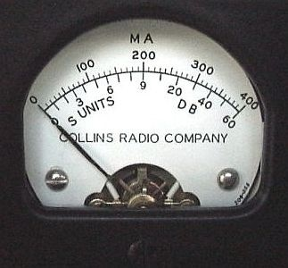
Decibels
A doubling of power results in a change of 3dB higher
Transmitter’s power can be reduced 3dB by reducing the power by half
Transmitter’s power can be increased by 6dB by quadrupling power

Slide 30
Decibels
If a signal-strength report is “10dB over S9”, reducing transmitter power from 1500 watts to 150 watts should produce a report of “S9”
If a signal-strength report is “20dB over S9”, reducing transmitter power from 1500 watts to 150 watts should produce a report of “S9 plus 10dB”
Other examples:
Power output increases from 1 watt to 2 watts = 3.0 dB received power increase
Power output increases from 5 watts to 50 watts = 10 dB received power increase

