Slide 1
CHAPTER 5
WAVES, WAVELENGTHS, FREQUENCIES

Slide 2
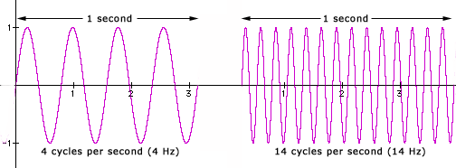
Frequency
The number of cycles per unit of time is called the frequency.
For convenience, frequency is most often measured in cycles per second or Hertz (Hz)
60 cycles per second = 60 Hz. 1000 Hz is often referred to as 1 kHz (kilohertz) or simply '1k’
The range of human hearing in the young is approximately 20 Hz to 20 kHz. The higher number tends to decrease with age (as do many other things). A 60-year-old may hear a maximum of 16,000 Hz.
Signals in the range of 20 Hz to 20,000 Hz are called audio frequencies, because the human ear
can sense sounds in this range.

Slide 3
Relationship of Frequency and Wavelength
The distance a radio wave travels in
one cycle is called wavelength.
V+
One Cycle
0V
time
V-
One Wavelength

Slide 4
Classes of Waves
- Voice frequencies are low-frequency sound waves in the range between 300 and 3000 Hertz.
Electromagnetic waves that oscillate more than 20,000 times per second as they travel through space are generally referred to as radio waves
Most of the radio waves that amateurs create and listen to are in the range of 1.8 MHz to 440 MHz, with some amateurs using higher frequencies up into the gigahertz range

Slide 5
Frequency & Wavelength
- Frequency is the number of times that current alternates back and forth per second
- Wavelength is the distance a radio wave travels during one complete cycle
- The wavelength gets shorter as the frequency increases
The wavelength in meters equals 300 divided by the frequency in megahertz. For example, for a radio tuned to 14.200 MHz:
Wavelength = 300 / 14.200 MHz = 21.13 meters
(commonly rounded and referred to as “the 20-meter band”)
A radio wave travels through space at the speed of light!

Slide 6
Frequencies and Bands
The wavelength property of a radio wave is used to identify the different bands that are available for amateur radio operators to use.
The frequency range of the “2-meter band” in Canada is 144 to 148 MHz
Example: 300 / 145.350 MHz = 2.06 meters
The frequency range of the “6-meter band” in Canada is 50 to 54 MHz
Example: 300 / 52.0 MHz = 5.77 meters
The frequency range of the “70-centimeter band” in Canada is 420 to 450 MHz
Example: 300 / 440.0 MHz = 0.68 meters
The frequency range of the “160-meter band” in Canada is 1.8 to 2.0 MHz
Example: 300 / 1.850 MHz = 162.16 meters

