Slide 1
CHAPTER 4
INDUCTORS & CAPACITORS

Slide 2
Inductance and Inductors
Two fundamental principles of electromagnetics:
    Moving electrons create a magnetic field
    Change in a magnetic field causes electrons to move… it induces a current
An inductor is a coil of wire through which electrons move, and energy is stored in the resulting magnetic field
Notes:
A very good demonstration of the two fundamental principles is to drop a strong magnet through a conductive pipe (such as copper or aluminum and a non conductive pipe such as PVC). The magnet falls right through the non conductive pipe as expected, but drops slowly though the aluminum pipe, and even more slowly through the copper pipe. What is happening is that the moving magnetic field tries to cause the electrons in the conductor to move, those electrons in turn create and opposing magnetic field that slows the magnet's decent. The magnet falls through copper slower because copper is a better conductor than aluminum.
A good source of magnets for this demonstration is at:
http://www.gaussboys.com/product_info.php?products_id=31

Slide 3
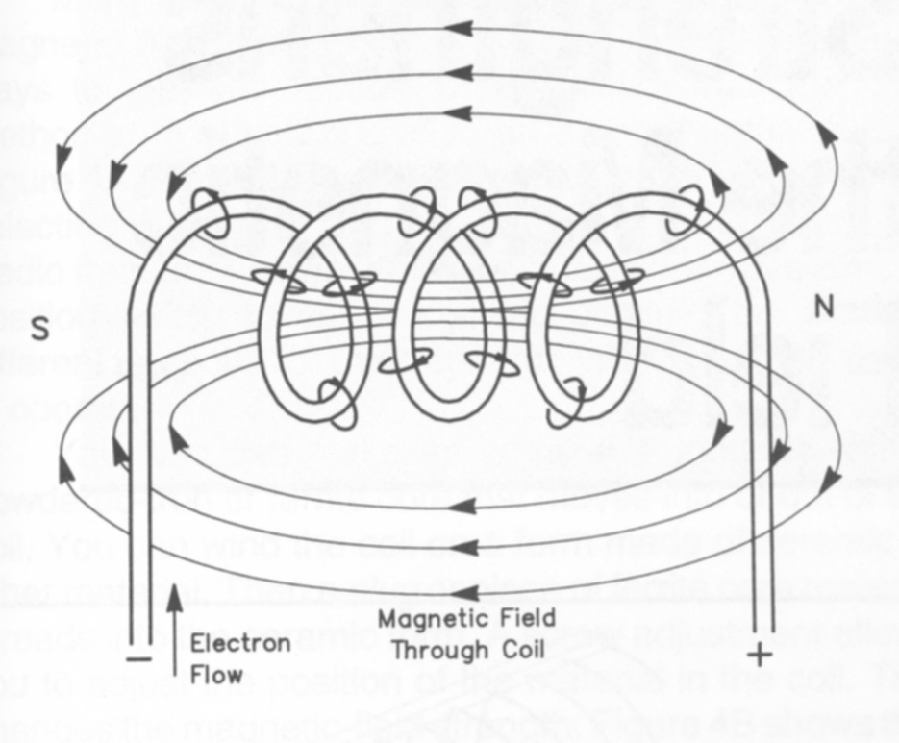
Inductors
Like capacitors, inductors temporarily store energy
Unlike capacitors:
  Inductors store energy in a magnetic field, not an electric field
  When the source of electrons is removed, the magnetic field collapses immediately

Slide 4
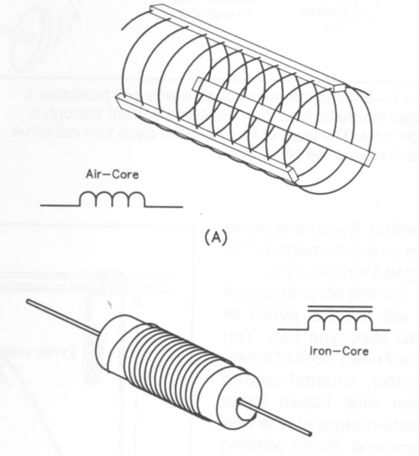
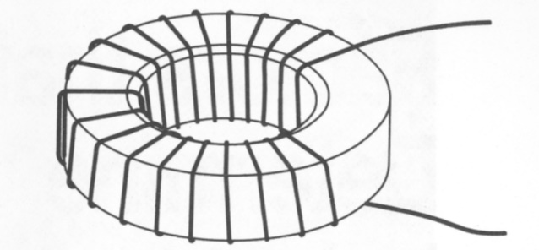
Inductors
Inductors are simply coils of wire
  Can be air wound (just air in the middle of the coil)
  Can be wound around a permeable material (material that concentrates magnetic fields)
  Can be wound around a circular form (toroid)
Notes:
Discuss with the audience the physical makeup of the typical inductor … a coil of wire. The permeable material (meaning it accepts and concentrates magnetic fields) helps to generate a larger magnetic field in the inductor without adding wire. The permeable materials are metallic mixtures that usually include iron. The magnetic field created by an inductor surrounds the inductor. The toroid, or doughnut form, helps to keep the magnetic field contained within the immediate vicinity of the inductor. This is sometimes desirable so that inductors near each other will not interact.

Slide 5
Inductors
Inductance is measured in Henrys
A Henry is a measure of the intensity of the magnetic field that is produced
Typical inductor values used in electronics are in the range of millihenry (1/1000 Henry) and microhenry (1/1,000,000 Henry)
Notes:
As in capacitance and the Farad, a single Henry is a huge amount of inductance and would require a very large component. In electronics, the values of inductance are generally in the milli and micro ranges.

Slide 6
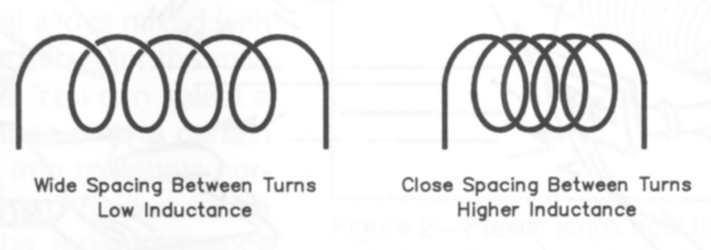
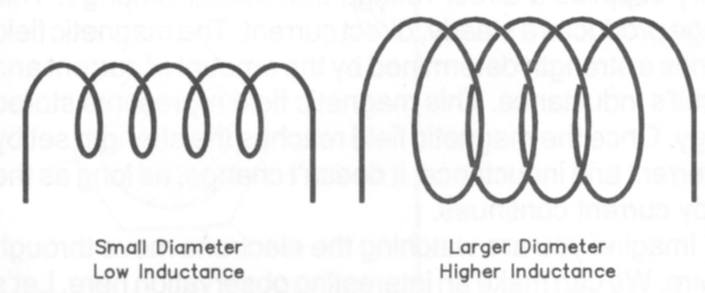
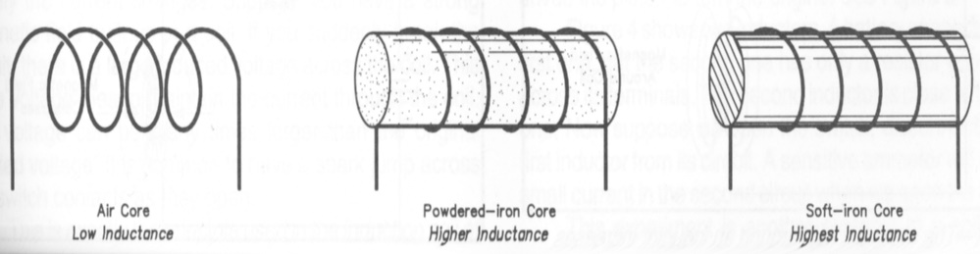
Inductors
The amount of inductance is influenced by a number of factors:
  Number of coil turns
  Diameter of coil
  Spacing between turns
  Size of the wire used
  Type of material inside the coil
Notes:
All of these factors contribute to the value of inductance. All of these factors are mathematically related and an inductors value can be predicted pretty well if these dimensions are known. The math and the formulas are beyond the scope of this course, but they are by no means too difficult for those in the audience that are interested.

Slide 7
Inductor Performance
With DC Currents
When a DC current is first applied to an inductor, the increasing magnetic field opposes current flow - current flow is at a minimum
Eventually (milliseconds) the magnetic field achieves its maximum and current flows, maintaining the field
As soon as the current source is removed, the magnetic field begins to collapse and creates a rush of current in the other direction, sometimes at very high voltage
Notes:
Take some time to talk your audience through the process as a DC current flows through the inductor. During the building of the magnetic field, that process actually impedes the growth of the field, but the current flow will prevail to build up the field to the maximum. But when the current is suddenly taken away, the field immediately begins to collapse with a resulting high voltage across the inductor. This is how the high voltages are generated in a car to cause the ignition spark.

Slide 8
Inductor Performance
With AC Currents
When AC current is applied to an inductor, during the first half of the cycle, the magnetic field builds as if it were a DC current
During the next half of the cycle, the current is reversed and the magnetic field decreases the reverse polarity in step with the changing current
These forces can work against each other resulting in a lower current flow
Notes:
Now with AC current, the current and the magnetic field are constantly reversing. The inductor causes a “delaying action” for the reacting current. These properties actually act against each other. The result is that collapsing magnetic field and the reverse generated current all combine to act like resistance to the current flow, this type of resistance is called reactance. As the frequency of the AC current increases, the apparent resistance (reactance) increases. This makes sense, a straight wire, one with no coiled turns, would only exhibit pure resistance to the flow of electrons through the wire. But once you start to coil the wire and focusing the induced magnetic field, the inductor properties and the changing magnetic field will add additional resistance (reactance) to the flow of electrons.

Slide 9
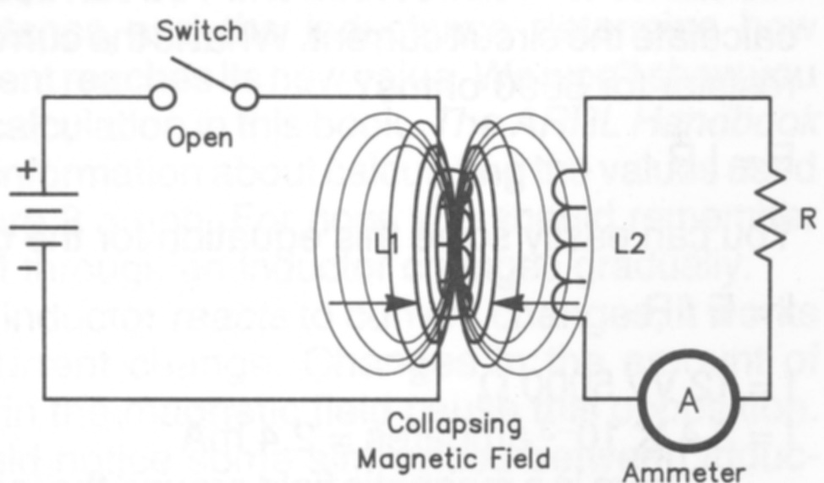
Inductors
Because the magnetic field surrounding an inductor can cut across another inductor in close proximity, the changing magnetic field in one can cause current to flow in the other.
This is the basis of transformers
Notes:
Pairs of inductors in close proximity is another important use of inductors in electronics. The household transformer that converts 120V AC wall current into current that will run a 12V DC radio probably uses a transformer and other circuits to do the conversion. It is important to go back to the two fundamental principles stated earlier in this unit (moving electrons create magnetic fields, changing magnetic fields cause electrons to move). This would be a good opportunity to walk your audience through the process while discussing how a transformer works.

Slide 10
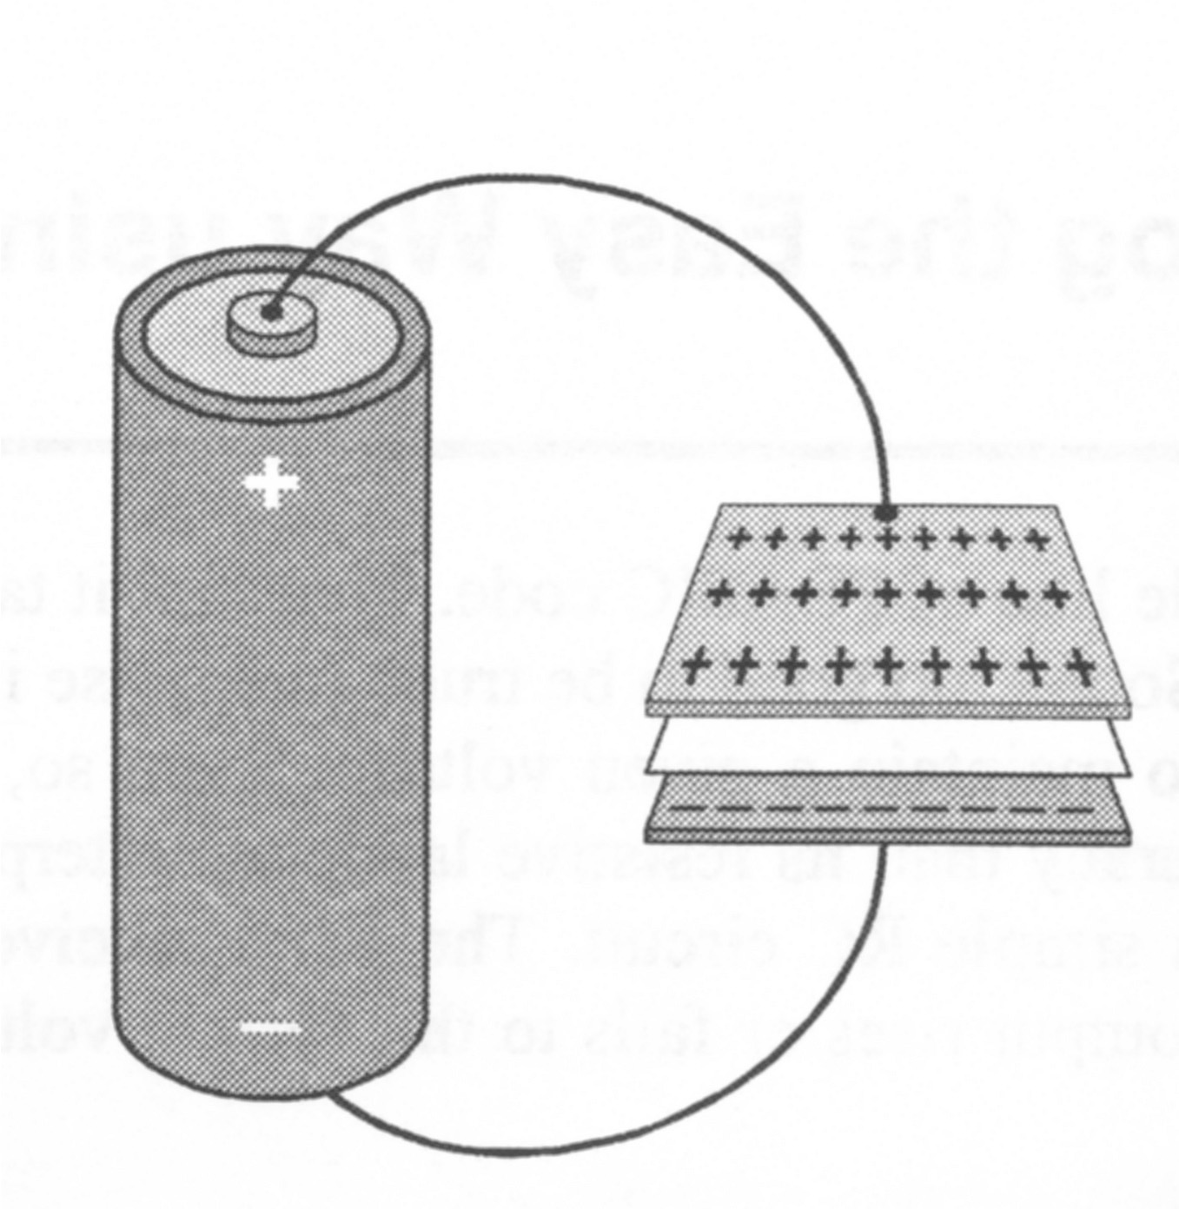
Capacitors

Slide 11
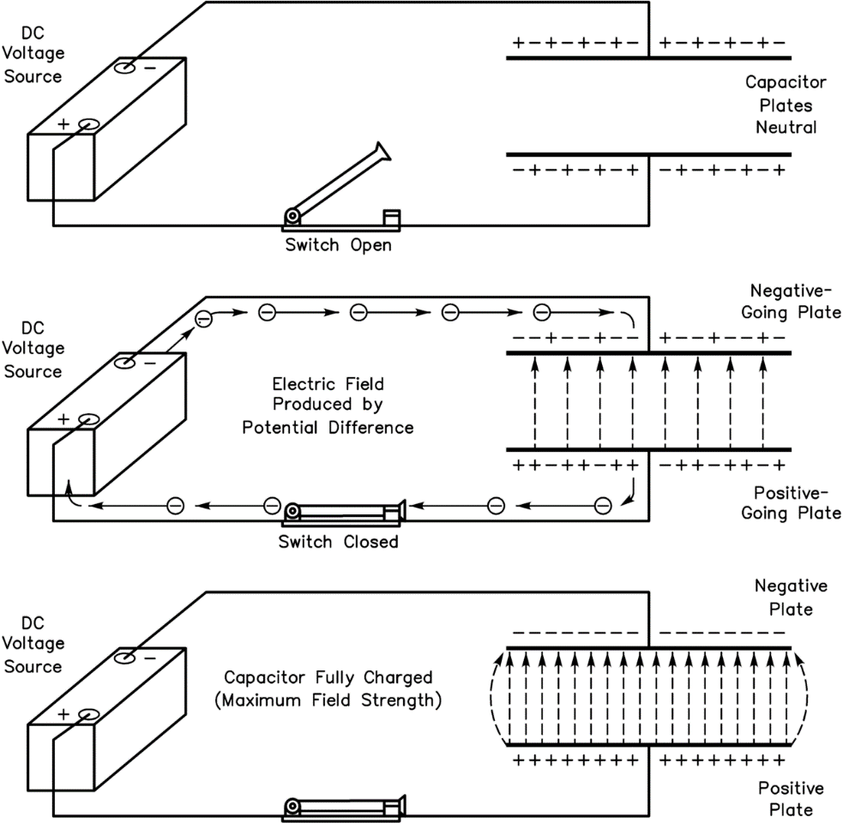
Capacitors
Devices that store energy in an electric field
Two conductive plates separated by a non-conductive material
Electrons accumulate on one plate, forcing electrons away from the other plate and leaving a net positive charge
Think of capacitors as small temporary storage batteries
Notes:
Bring to the audience the analogy of static electricity when they comb their hair or take clothing out of a dryer. Apposing charges build up on the comb and hair. When the comb is brought into proximity to the hair, the hair is attached to the comb and stands on end. Everyone has experienced static discharge with an unexpected spark. The phenomena is basically how a capacitor works, by storing that change.

Slide 12
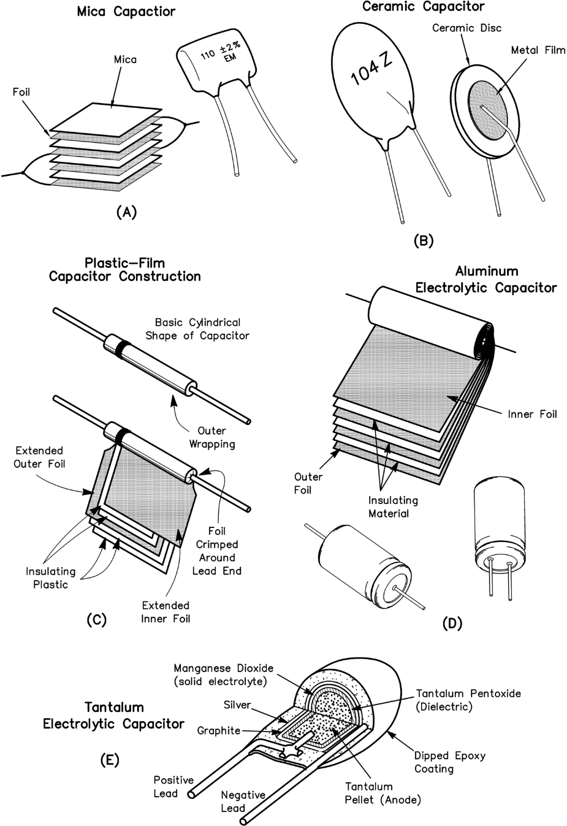
Capacitors
Capacitors are rated by:
  Amount of charge that can be held
  Voltage handling capabilities
  Insulating material between plates
Notes:
The basic unit of capacitance is the farad. A single farad in reality can hold a very large amount of charge and in electronic circuits, and the amount of capacitance is usually in the millionths and billionths of a farad (micro-farad, pico-farad, nano-farad).
Capacitors are identified by the type of insulating materials between the conductive plates, I.e., air, mica, tantalum, ceramic, polystyrene, etc.

Slide 13
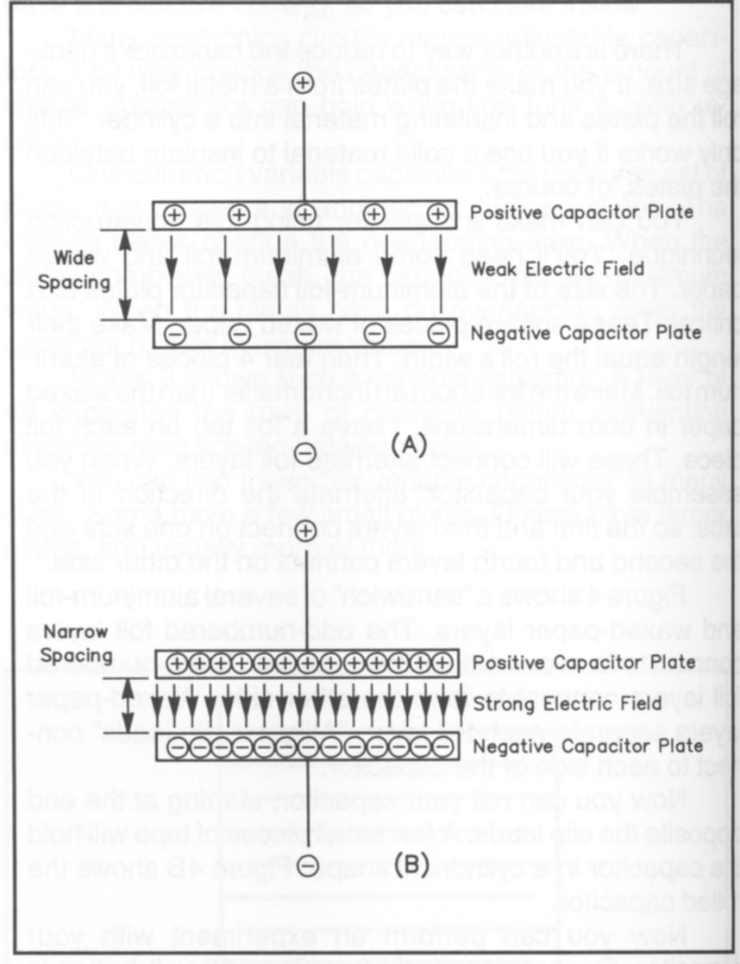
Capacitors
Ability to hold a charge depends on:
  Conductive plate surface area
  Space between plates
  Material between plates
Notes:
The value of the capacitor is determined by 3 physical factors:
The mount of surface area of the conductive plates. The larger the surface area, the more charge, and therefore the higher capacitance value.
The distance between the plates. The closer the conductive plates are to each other, the stronger the electrostatic field that is developed. When the plates are close together, the attraction between the opposing poles is stronger. The closer the plates are together the higher the capacitance.
The insulating material between the plates. Certain materials are more conducive to separating the poles than others, this allows capacitors to handle higher voltages or to hold a charge longer. Certain materials are very thermally stable and will not expand or contract as much with temperature changes therefore making the capacitance value more stable over wide operating temperatures.

Slide 14
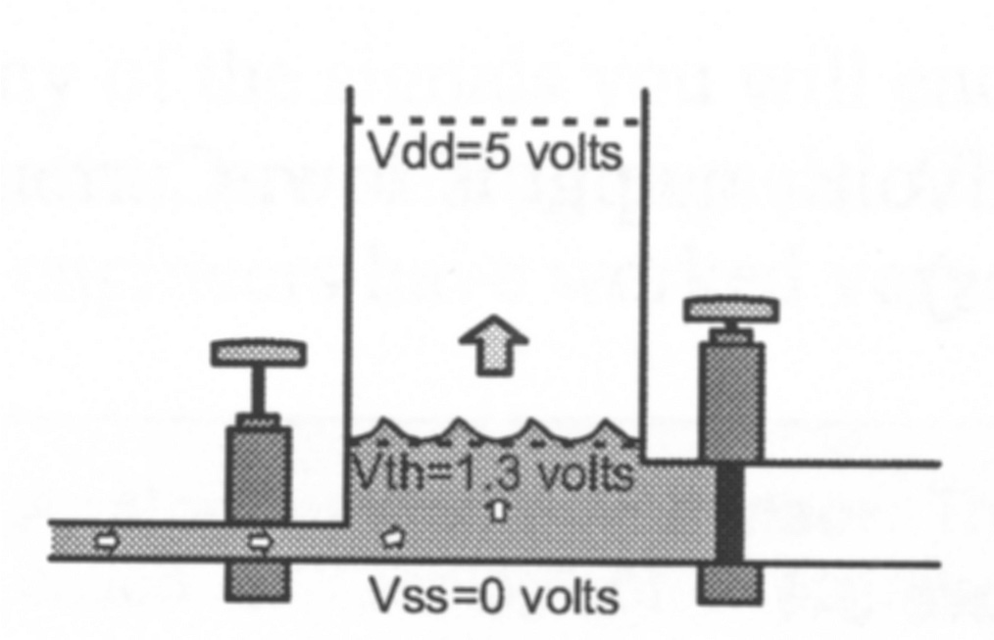
Charging a Capacitor
Notes:
Spend some time talking about how a capacitor is charged. Go back and use the water analogy to help explain how a capacitor works. In this illustration water (electrons) is entering the tank (capacitor) from the right. The rate that the water (electrons) enters the tank (capacitor) depends on how much pressure (voltage) pushing on the water. The outlet valve on the right is closed so water (electrons) can not escape. When there is no water (electrons) in the tank (capacitor), the reverse pressure (voltage) from the water (electrons) in the tank (capacitor) would be zero and the water (electrons) would rush into the tank (capacitor) un-impeded. When the tank (capacitor) has all the water (electrons) it can hold, the reverse pressure (voltage) of the water (electrons) would equal the pressure (voltage) pushing the water (electrons) in to the tank (capacitor) and the flow of water (electrons) would stop and remain constant. The tank (capacitor) is in a charged state with the pressure (voltage) inside the tank (capacitor) equal to the pressure (voltage) of the water (electron) supply.
In the beginning the water (electrons) rush in at a rapid rate because there is no opposing pressure (voltage) built up. As the opposing pressure (voltage) builds as more water (electrons) enters the tank (capacitor), the rate of water (electron) flow slows until it virtually stops when the tank (capacitor) is full.

Slide 15
Capacitors
When connected to a DC source, the capacitor charges and holds the charge as long as the DC voltage is applied
The capacitor essentially blocks DC current from passing through
Notes:
Point out to the audience that they used DC to charge the capacitor. Once the capacitor reaches full charge (the forward voltage equals the reverse pressure), the current ceases to flow, it stops, it is essentially blocked.

Slide 16
Capacitors
When AC voltage is applied, during one half of the cycle the capacitor accepts a charge in one direction
During the next half of the cycle, the capacitor is discharged then recharged in the reverse direction
During the next half cycle the pattern reverses
It acts as if AC current passes through a capacitor
Notes:
This is going to take a little more explaining. Talk the audience thorough the process after you review what AC is.
During the positive portion of the cycle, electrons are drawn from plate 1 and added to plate 2, the capacitor is charged with plate 2 being negative and plate 1 being positive.
After the peak of the positive cycle, the capacitor begins to discharge. When the cycle begins to go negative, electrons are added to plate 1 and drawn away from plate 2. The capacitor is charged with plate 1 being negative and plate 2 being positive.
If the audience looks at just one plate, the plate goes from positive to negative and back again … just as if the plate were a source of AC!

Slide 17
Capacitors
The unit of capacitance is the farad
  A single farad is a huge amount of capacitance
  Most electronic devices use capacitors that are a very tiny fraction of a farad
Common capacitance ranges are:
  Micro 10⁻⁶
  Nano 10⁻⁹
  Pico 10⁻¹²
Notes:
Point out to the audience the wide range of capacitance values. The most common values are micro and pico farad though sometimes you will see values listed as nano farad.

Slide 18
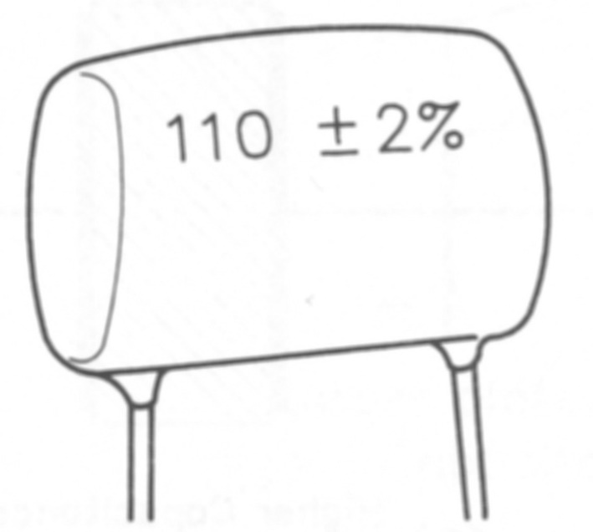
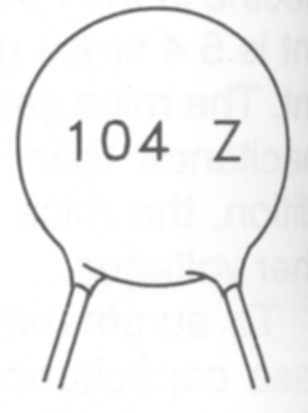
Capacitors
Capacitor value identification depends on the capacitor type
Could be color bands, dots, or numbers
Wise to keep capacitors organized and identified to prevent a lot of work trying to re-identify the values
Notes:
Capacitor identification can be a little tricky and complicated. These two illustrations show the typical numbering system. Here are some common examples:
1uf = 105
.1uf = 104
.01us =103
1000pf = 1nf = 102
.047uf = 473
.022uf = 223

Slide 19
Capacitors in Circuits
Three physical factors affect capacitance values
  Plate spacing
  Plate surface area
  Dielectric material
In series, plates are far apart making capacitance less
+
Charged plates far apart
-
Notes:
The audience should already be familiar with parallel, series, and mixed circuits from the previous discussion. There is a little twist that is important when dealing with capacitors in circuits, the mathematics is the opposite of what they use with resistance, i.e., parallel capacitances are a simple sum, series capacitance is the reciprocal sum.
It is fairly easy to see why there is a difference if the audience goes back to what physical factors affect the amount of capacitance, or the amount of charge the device can hold. There are two physical factors, the surface area of the conductive plates and the distance between the conductive plates.
In a series circuit, take a look at the plate closest to the negative pole of the source and the plate closes to the positive pole of the source. These plates are physically more separated from each other than if there was a single capacitor. Since the plates appear to be wider apart, the electrons on the negative plate, and the positive charge (lack of electrons) on the positive plate cannot influenced each other as much, and therefore the electric field is weaker, and the capacitance is less.

Slide 20
Capacitors in Circuits
In parallel, the surface area of the plates add up to be greater
This makes the total capacitance higher
+
-
Notes:
The surface area of the conductive plates in parallel capacitors add together. The electrons on the plates connected to the negative pole of the source spread out across both capacitor’s plate, the positive change (absence of electrons) on the plates attached to the positive pole of the source also spread out, the plates are still only separated by the same distance as if there was just a single capacitor. So there is more electrons are exposed over a greater surface but at the same distance, therefore the capacitance will be more. The simple sum.
The two formulas should look familiar. Emphasize with the students that even though the formulas look the same as the ones used for series and parallel resistances, the mechanism that these formulas represent are different between resistors and capacitors. The important thing to remember, that the formulas are applied opposite between resistors and capacitors.

Slide 21
Magnetics & Transformers
A transformer is just two (or more) inductors sharing a common magnetic path
Any two inductors placed reasonably close to each other will work as a transformer
The more closely they are coupled magnetically, the more efficient they become.
When a changing magnetic field is in the vicinity of a coil of wire (an inductor), a voltage is induced into the coil which is in sympathy with the applied magnetic field.
A static magnetic field has no effect, and generates no output.
Many of the same principles apply to generators, alternators, electric motors and loudspeakers

Slide 22
Magnetics & Transformers
When an electric current is passed through a coil of wire, a magnetic field is created - this works with AC or DC, but with DC, the magnetic field is obviously static. For this reason, transformers cannot be used directly with DC, for although a magnetic field exists, it must be changing to induce a voltage into the other coil
The ability of a substance to carry a magnetic field is called permeability, and different materials have different permeability. Some are optimized in specific ways for a particular requirement - for example the cores used for a switching transformer are very different from those used for normal 50/60Hz mains transformers

Slide 23
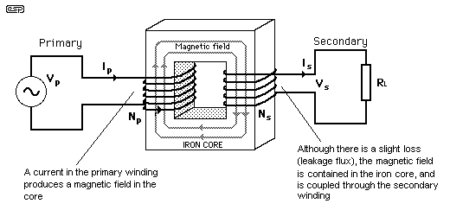
Magnetics & Transformers
Essential Workings of a Transformer
Figure 1.1 shows the basics of all transformers. A coil (the primary) is connected to an AC voltage source - typically the mains for power transformers. The flux induced into the core is coupled through to the secondary, a voltage is induced into the winding, and a current is produced through the load.

Slide 24
Magnetics & Transformers
  At no load, an ideal transformer draws virtually no current from the mains, since it is simply a large inductance.
  The principle of operation is based on induced magnetic flux, which not only creates a voltage (and current) in the secondary, but the primary as well
  The voltage generated in the primary is called a "back EMF" (electromotive force). The magnitude of this voltage is such that it almost equals (and is effectively in the same phase as) the applied EMF.
  When a load is applied to the output (secondary) winding, a current is drawn by the load, and this is reflected through the transformer to the primary.
  As a result, the primary must now draw more current from the mains. Somewhat intriguingly perhaps, the more current that is drawn from the secondary, the original 90 degree phase shift becomes less and less as the transformer approaches full power.
  The power factor of an unloaded transformer is very low, meaning that although there are volts and amps, there is relatively little power. The power factor improves as loading increases, and at full load will be close to unity (the ideal).
  Transformers are usually designed based on the power required, and this determines the core size for a given core material. From this, the required "turns per volt" figure can be determined, based on the maximum flux density that the core material can support. Again, this varies widely with core materials.

