Slide 1
CHAPTER 3
Ohm’s Law, Power

Slide 2
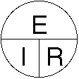
Ohm’s Law
There is a very easy way to determine how much current will flow through a circuit when the voltage and resistance is known.
The simple equation is as easy as (don't let the word scare you) “pie”
Remember the “pie” below. The pie/circle will help you to know how to figure out the answer to these electrical problems. The three letters stand for...
E = electromotive force (a.k.a. Voltage)
I = intensity (French term for Current)
R = resistance

Slide 3
Ohm’s Law
E = electromotive force (a.k.a. Voltage)
I = intensity (the French term for Current)
R = resistance
Voltage: E = I x R (Volts)
Current: I = E / R (Amps)
Resistance: R = E / I (Ohms)

Slide 4
Ohm’s Law
A circuit has 200 volts with 100 ohms of resistance. How much current would flow?
Since our "unknown" value in this problem is the current, then we can put our finger over the "I“.
What’s left is "E over R". This means you take the Voltage and divide it by the Resistance. 200 volts divided by 100 ohms equals 2 amps.
E = electromotive force (a.k.a. Voltage)
I = intensity (French term for Current)
R = resistance

Slide 5
Ohm’s Law
We want to determine the voltage in a circuit when we know the current is 2 amps and the resistance is 50 ohms.
Look at the "pie" and cover up the E. You're left with I times R.
Voltage = 2 amps time 50 ohms = 100 volts
E = electromotive force (a.k.a. Voltage)
I = intensity (French term for Current)
R = resistance

Slide 6
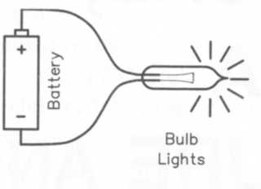
Power
Every circuit uses a certain amount of power
Power describes how fast electrical energy is used
When you close a circuit containing an incandescent light bulb, heat and light are produced in the bulb by the current flowing through a resistive filament in the bulb.
The resistance turns the electrical power into primarily heat, and secondarily light.
Each light bulb is rated at a certain power rating, an expression of how much power the bulb will use in the rated circuit. The rated power usage is expressed in watts.

Slide 7

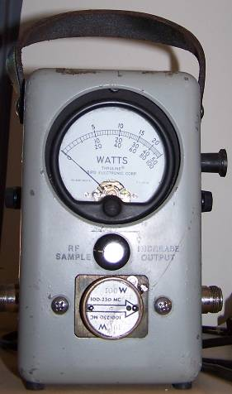
Power Calculations
The unit used to describe electrical power is the Watt.
The formula for calculating power is
Power (P) equals voltage (E) times current (I) P = E X I
Use another pie!

Slide 8
Power Calculations
How much power is represented by a voltage of 13.8 volts DC and a current of 10 amperes?
P = I x E P = 10 x 13.8 = 138 watts
How much power is used in a circuit when the voltage is 120 volts DC and the current is 2.5 amperes.
P = I x E P = 2.5 x 120 = 300 watts

Slide 9
Power Calculations
How many watts are consumed by a transceiver when you are transmitting?
By measuring the DC voltage at the transceiver and multiplying by the current drawn when you transmit…
P = E X I = (Power = 12 volts X 20 amps) = 240 watts
How many amperes is flowing in a circuit when the applied voltage is 120 volts DC and the load is 1200 watts?
I = P / E = (Current = 1200 watts / 120 volts) = 10 amperes

Slide 10




Power Calculations
Memorizing Ohm's law
Power Formula P= I x E
Lets try some examples we are familiar with;
P= 60 watt light bulb
E=120 volts
I= .5 amps
P=100 watt light bulb
E=120 volts
I=.83 amps
Electric Kettle consumes
P=900 watts
E=120 volts
I= 7.5 amps
Electric Toaster
P= 1200 watts
E=120 volts
I=10 amps
Power: P = I x E (Watts)‏
Current: I = P / E (Amps)‏
Voltage: E = P/ I (Volts)‏
E = Electromotive Force aka Volts
I = Intensity aka Current

