Slide 1
CHAPTER 2
Basic Electronics & Theory
(The rules behind all those little things)

Slide 2
Metric Prefixes
Metric prefixes you'll need to know ...
1 Giga (G) = 1 billion = 1,000,000,000
1 Mega (M) = 1 million = 1,000,000
1 kilo (k) = 1 thousand = 1,000
1 centi (c) = 1 one-hundredth = 0.01
1 milli (m) = 1 one-thousandth = 0.001
1 micro (u) = 1 one-millionth = 0.000001
1 pico (p) = 1 one-trillionth = 0.000000000001
... and a few you might want to know ...
1 Tera (T) = 1trillion = 1,000,000,000,000
1 hecto (h) = hundred = 100
1 deci (d) = 1 tenth = 0.1
1 nano (n) = 1 one-billionth = 0.000000001

Slide 3
Metric Prefixes
The prefix enables us to reduce the amount of zeros that are used in writing out large numbers.
For example…
Instead of saying that the frequency of a signal is 1,000,000 Hz
(Hz = Hertz, or cycles per second)
We say it is 1 Megahertz (MHz) or 1,000 kilohertz (kHz)
The prefix enables us to write the number in a shorter form
This becomes especially useful when we need to measure or record very large or very small values

Slide 4
Metric Prefixes
Mega = one million = 1,000,000
Let’s go back and look at large frequencies again
1,000 Hz = 1 kHz
"One thousand Hertz equals one kilohertz"
1,000,000 Hz = 1 MHz
"One million Hertz equal one megahertz"
How many kilohertz are in one megahertz?
1000 kHz = 1 MHz
"One thousand kilohertz equals one megahertz"
If a radio is tuned to 7125 kHz, how do we express it in megahertz?
1000 kHz = 1 MHz || 7125 kHz = 7.125 MHz

Slide 5
Metric Prefixes
Mega = one million = 1,000,000
Another frequency problem: your dial reads 3525 kHz. What is the same frequency expressed in Hertz?
1 kHz = 1000 Hz || 3525 kHz = 3,525,000 Hz
(Notice that since we have to add three zeros to go from 1 kHz to 1000 Hz, we must also do the same to go from 3525 kHz to 3,525,000 Hz.)
Your displays shows a frequency of 3.525 MHz What is that same frequency in kilohertz?
1 MHz = 1000 kHz || 3.525 MHz = 3525 kHz
(See how the 1 became 1000? To go from megahertz to kilohertz, you multiply by 1000. Try multiplying 3.525 MHz by 1000 to get your frequency in kilohertz.)

Slide 6
Metric Prefixes
Giga = one billion = 1,000,000,000
Remember, kilo equals one thousand, and mega equals one million
One billion Hertz is one gigahertz (GHz).
You are transmitting on 1.265 GHz, what is your frequency in megahertz?
1 GHz = 1000 MHz || 1.265 GHz = 1265 MHz
These prefixes make it easier to express the large and small numbers commonly used in radio and electronics

Slide 7
Metric Prefixes
Milli = one one-thousandth = 0.001
If you were to take an ammeter (a meter that measures current) marked in amperes and measure a 3,000 milliampere current, what would your ammeter read?
1,000 mA = 1 A || 3,000 mA = 3 A

Slide 8
Metric Prefixes
Now lets say, on a different circuit, you were using a voltmeter marked in volts (V), and you were measuring a voltage of 3,500 millivolts (mV). How many volts would your meter read?
1,000 mV = 1 V || 3,500 mV = 3.5 V
How about one of those new pocket sized, micro handheld radio you're itching to buy once you get your license? One manufacturer says that their radio puts out 500 milliwatts (mW) , while the other manufacturer's radio will put out 250 milliwatts (mW). How many watts (W) do these radios really put out?
1000 mW = 1 W || 500 mW = 0.5 W
1000 mW = 1 W || 250 mW = 0.25 W

Slide 9
Metric Prefixes
Micro = on one-millionth = 0.0000000001
Capacitors usually have very small values. A one-farad capacitor is seldom used in commercial electronics.
Usually, capacitors have values in the range of thousandths of a farad to trillionths of a farad
Micro and pico are the opposite end of the scale compared with kilo, mega, and giga… they indicate very small values
If a capacitor has a value of 500,000 microfarads, how many farads would that be?
Since it takes one million microfarads to equal one farad...
1,000,000 uF = 1 F || 500,000 uF = 0.5 F

Slide 10
Metric Prefixes
Pico = one one-trillionth = 0.000000000001
What if a capacitor has a value of 1,000,000 picofarads? One picofarad is one trillionth of a farad. One picofarad is also one millionth of a microfarad. So it takes one million picofarads (pF) to equal one microfarad (uF):
1,000,000 pF = 1 uF
It takes one trillion (i.e. one million-million) picofarads (pF) to equal one farad (F):
1,000,000,000,000 pF = 1 F

Slide 11
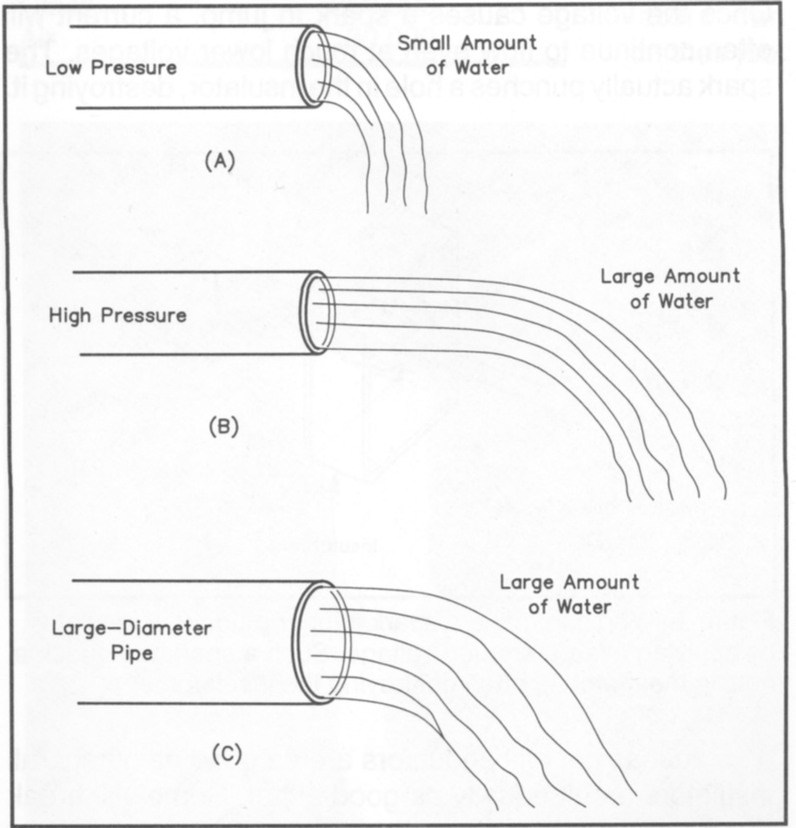
Current, Voltage, Resistance
Water flowing through a hose is a good
way to imagine electricity. Water is like
Electrons in a wire.
Flowing electrons are called Current
Pressure is the force pushing water
through a hose – Voltage is the force
pushing electrons through a wire
Friction against the hose walls slows
the flow of water – Resistance is an
impediment that slows the flow of
electrons
.
Notes:
Use the water analogy to explain the components of electricity. Have the audience visualize water flowing through a garden hose and then ask them to think what happens when:
They increase the pressure forcing the water through the hose by opening up the spigot – the water flows faster and squirts farther. The opposite happens when they reduce the pressure, the water flows slower, right down to a trickle. In electricity, the force pushing electrons through the wire, current, is voltage. If the voltage is increased, more current flow, if the voltage is decreased, less current flow.
Now imaging keeping the pressure constant and visualize what happens when they change the amount of water available to flow through the hose. If there is lots of water, the water will flow out at full force, if there is limited water, no matter how hard you push, the water will only flow out at a small trickle. In electricity, if there is ample current available, it will flow through the wire at full capacity, if you limit somehow the amount of current, then the current will only flow at a reduced rate.
Finally, image what would happen if you kept the pressure and the amount of water available constant, but restricted the diameter of the hose (like putting your finger over the end). The restriction prevents the all the water from coming out, but the water that does come out comes out with greater force (it will squirt further). Also the water behind the restriction actually slows way down to wait its turn to go out of the restricted hole. The same thing would happen if the interior wall of the hose was made very, very ruff. The water molecules would run into the ruff surface and slow down, this is very much like friction. In electricity, the current does not flow through a wire without running into something along the way, this is always some friction, but in electricity that friction is called resistance. When resistance goes up, the amount of current flow goes down, when resistance goes down, the amount of current flow goes up.
Ask the audience to do two things to reinforce the concept of resistance. First, ask them to rub their hands rapidly together and observe the sensation … heat. The friction between their hands, the resistance to the movement of their hands across each other, creates heat. The same is true in electricity as well as water flowing in a hose (though they might not feel the heat generated in the hose). Second, ask them to do an experiment at home, rapidly pump a bicycle air pump and feel the air hose, the hose can get quite hot. That is a demonstration of resistance (friction) in action.
Conclude by pointing out that during the water hose discussion, the three components of water flowing through the hose were inter related, you really can’t change one without affection some change in one of the other two components. The same is true in electricity and we will be discussion that relationship later.

Slide 12
Two Types of Current
Direct Current (DC)
Flows in only one direction from negative toward positive pole of source
Alternating Current (AC)
Flows back and forth because the poles of the source alternate between positive and negative
Notes:
Emphasize that current type comes only from how the current flows in a wire. If it flows only in one direction, the current is Direct Current (DC), if the current alternates from flowing in one direction one moment and then reversing to the other direction the next moment, the current is Alternating Current (AC). Also emphasize that current magnitude (amplitude) is not a determinant of current type. DC does not have to be constant, as is normally the case of current flowing from a battery, DC only flows in one direction even if the amplitude varies.
Discuss the sources of DC and AC. Make note that both types of current are used in electronic devices. DC is generally used as sources of power for circuits. AC is generally used as signal sources to transfer energy or intelligence (information like voice, media like radio waves).
Point out that there are dedicated circuits within an electronic device that converts AC to DC and DC to AC, and from one AC current to another AC current.

Slide 13
Conductors & Insulators
Electricity flows easily through some materials. These materials are called conductors. Most conductors are metals, and some of the best conductors are
gold, silver, aluminum and copper
Some materials resist or prevent the flow of electricity through them. These insulators include such materials as
glass, air, plastic, and porcelain

Slide 14
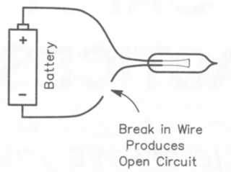
Open Circuit
In an open circuit no current flows. A break or open in a DC circuit makes it impossible for electrons to complete a journey from negative to positive poles, so nothing flows.
For example, when a switch in a circuit is turned off, it creates an open circuit by creating a break or opening in the circuit, and current stops flowing. When it is turned on, the “path” from negative to positive poles is completed and current flows.
You probably figured that since there are "open circuits" that there are probably also "closed
circuits". Well, a closed circuit is when the switch is closed and current is allowed to flow
through the circuit.
A fuse is a device that is used to create an open circuit when too much current is flowing.

Slide 15
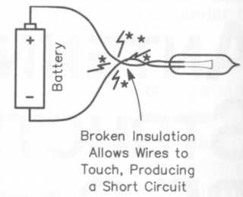
Short Circuit
A short circuit usually occurs when the intended path of electron flow is abruptly shortened, often by crossing uninsulated wires or touching other components together.
Since a circuit usually has some resistance, and the power wires or touching components that "short out" have little resistance, current will tend to flow through the path of least resistance... the location of the short circuit.
Less resistance at the same amount of voltage results in greater current flow, which can damage components not designed for it.
What is the best way to stop a short circuit from doing damage (because it is drawing too much power from the source)?
A fuse. Fuses are designed to work up to a certain amount of current (e.g. 1 amp, 15 amps, etc.)
When the maximum rated current is exceeded, the wire within the fuse burns up from the heat of the current flow, breaking the circuit and creating an open circuit… no more current flow.

Slide 16
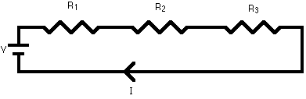
Resistors - Series Circuits
A series circuit is a circuit in which resistors are arranged in a chain, so the current has only one path to take.
The current is the same through each resistor. The total resistance of the circuit is found by simply adding up the resistance values of the individual resistors:
R = R1 + R2 + R3 + ...

Slide 17
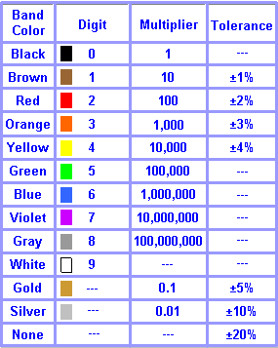
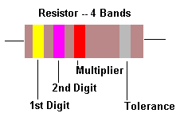
Resistor Fundamentals
Resistor Colour Codes & Tolerances
0 1 2 3 4 5 6 7 8 9
Bad Booze Rots Our Young Guts But Vodka Goes Well Black Brown Red Orange Yellow Green Blue Violet Gray White

Slide 18
Resistor Fundamentals
The color code chart is applicable to most of the common four band and five band resistors. Five band resistors are usually precision resistors with tolerances of 1% and 2%. Most of the four band resistors have tolerances of 5%, 10% and 20%.
The color codes of a resistor are read from left to right, with the tolerance band oriented to the right side. Match the color of the first band to its associated number under the digit column in the color chart. This is the first digit of the resistance value. Match the second band to its associated color under the digit column in the color chart to get the second digit of the resistance value.
Match the color band preceding the tolerance band (last band) to its associated number under the multiplier column on the chart. This number is the multiplier for the quantity previously indicated by the first two digits (four band resistor) or the first three digits (five band resistor) and is used to determine the total marked value of the resistor in ohms.

Slide 19
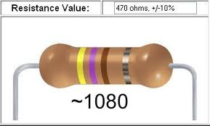
Resistor Fundamentals
To determine the resistor's tolerance or possible variation in resistance from that indicated by the color bands, match the color of the last band to its associated number under the tolerance column. Multiply the total resistance value by this percentage.
Example of a 4-Band Resistor
Colours: Band 1 (Value): YELLOW (4)
Band 2 (Value): VIOLET (7)
Band 3 (Multiplier): BROWN (1)
Band 4 (Tolerance): SILVER (10%)
Value: Resistance: 470 Ohms
Preferred Value: 470 Ohms (10%)
Tolerance: 10%

Slide 20
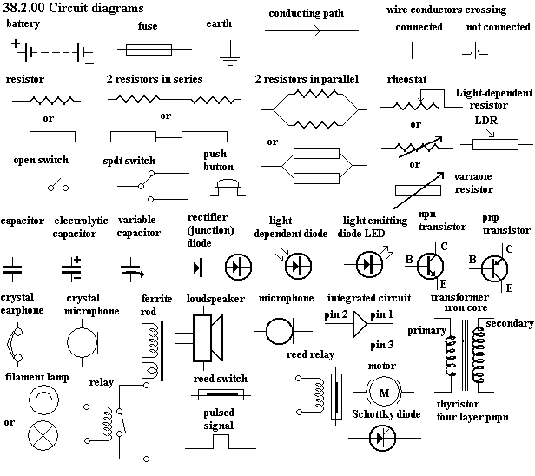
Resistor Fundamentals

Slide 21
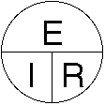
Resistors – Series Circuit
A series circuit is shown in the diagram below. The current flows through each resistor in turn. If the values of the three resistors are:
With a 12 V battery, by E = I X R the total current in the circuit is:
I = E / R = (12 / 20) = 0.6 A
The current through each resistor would be 0.6 amps

Slide 22
Resistors – Series Circuit
R = R1 + R2 + R3 + ...
R1 = 100 ohms
R2 = 150 ohms
R3 = 370 ohms
RT = ? ohms

Slide 23
Resistors – Parallel Circuits
A parallel circuit is a circuit in which the resistors are arranged with their heads connected together, and their tails connected together.
The current in a parallel circuit breaks up, with some flowing along each parallel branch and re-combining when the branches meet again.
The voltage across each resistor in parallel is the same.
The total resistance of a set of resistors in parallel is found by adding up the reciprocals of the resistance values, and then taking the reciprocal of the total.
Equivalent resistance of resistors in parallel
1 / R = 1 / R1 + 1 / R2 + 1 / R3 +...

Slide 24
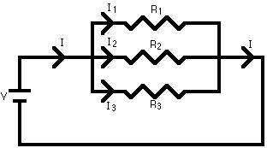

Resistors – Parallel Circuits
A parallel circuit is shown in the diagram above. In this case the current supplied by the battery splits up, and the amount going through each resistor depends on the resistance. If the values of the three resistors are:
With a 12 V battery, by E = I R the total current in the circuit is: I = E / R = 12 / 2 = 6 A
The individual currents can also be found using I = V / R. The voltage across each resistor is 12 V, so:
I1 = 12 / 8 = 1.5 A I2 = 12 / 8 = 1.5 A I3 = 12 / 4 = 3 A
Note that the currents add together to 6 A, the total current

Slide 25
Resistors – Parallel Circuits
1 / R = 1 / R1 + 1 / R2 + 1 / R3 +...
R1=100 ohms
R2=100 ohms
R3=100 ohms
RT= ? Ohms
RT = 1 / (1 / 100 + 1 / 100 + 1 / 100) = 33.33 ohms
Something to keep in mind. When you have resistors of equal value in parallel, RT = R/N where R is the value of one resistor and N is the number of resistors..

Slide 26
Resistors – Parallel Circuits
A parallel resistor short-cut
If the resistors in parallel are identical, it can be very easy to work out the equivalent resistance.
In this case the equivalent resistance of N identical resistors is the resistance of one resistor divided by N, the number of resistors. So, two 40-ohm resistors in parallel are equivalent to one 20-ohm resistor; five 50-ohm resistors in parallel are equivalent to one 10-ohm resistor, etc.
When calculating the equivalent resistance of a set of parallel resistors, people often forget to flip the 1/R upside down, putting 1/5 of an ohm instead of 5 ohms, for instance. Here's a way to check your answer. If you have two or more resistors in parallel, look for the one with the smallest resistance. The equivalent resistance will always be between the smallest resistance divided by the number of resistors, and the smallest resistance. Here's an example.
You have three resistors in parallel, with values 6 ohms, 9 ohms, and 18 ohms. The smallest resistance is 6 ohms, so the equivalent resistance must be between 2 ohms and 6 ohms (2 = 6 /3, where 3 is the number of resistors).
Doing the calculation gives 1/6 + 1/9 + 1/18 = 6/18. Flipping this upside down gives 18/6 = 3 ohms, which is certainly between 2 and 6.

Slide 27
Resistors – Parallel Circuits
Circuits with series and parallel components
Many circuits have a combination of series and parallel resistors. Generally, the total resistance in a
circuit like this is found by reducing the different series and parallel combinations step-by step to end up
with a single equivalent resistance for the circuit. This allows the current to be determined easily. The
current flowing through each resistor can then be found by undoing the reduction process.
General rules for doing the reduction process include:
Two (or more) resistors with their heads directly connected together and their tails directly connected
together are in parallel, and they can be reduced to one resistor using the equivalent resistance
equation for resistors in parallel.
Two resistors connected together so that the tail of one is connected to the head of the next, with no
other path for the current to take along the line connecting them, are in series and can be reduced to
one equivalent resistor.
Finally, remember that for resistors in series, the current is the same for each resistor, and for
resistors in parallel, the voltage is the same for each one

Slide 28
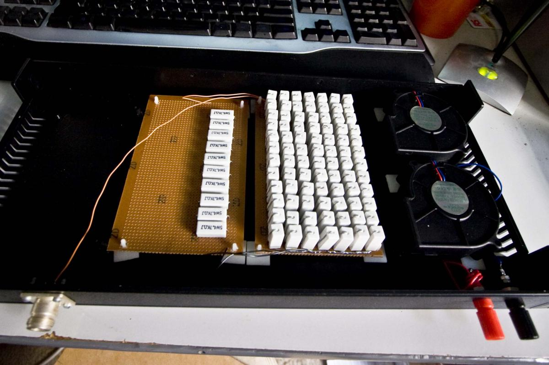
Resistors – Parallel Circuits
Why use a parallel resistor circuit?
Achieve a specific resistance level not available in readily-accessible resistors
Reduce current through resistors
A dummy load constructed of 94 resistors configured in a parallel circuit.
The device could withstand much more current / power than any one of the resistors, or all of them in series, could withstand.

Slide 29
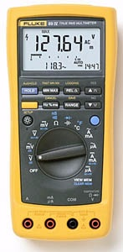
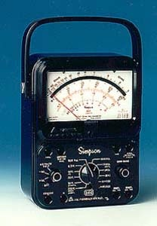
Multimeter Tool
Multimeters will measure Voltage, Current and Resistance.
Be sure it is set properly to read what is being measured.
If it is set to the ohms setting and voltage is measured the meter could be damaged!

Slide 30
Measuring Voltage
Potential difference (voltage) is measured with a voltmeter, the voltmeter is connected to
a circuit under test in parallel with the circuit
Voltmeter
Power Supply
Transceiver

Slide 31
Measuring Current
The instrument to measure the flow of electrical current is the ammeter. An ammeter is
connected to a circuit under test in series with the circuit
Ammeter
Power Supply
Transceiver

Slide 32
Measuring Resistance
The instrument to measure resistance is the ohmmeter. An ohmmeter is
connected to a circuit under test in parallel with the circuit
Ohmmeter

