Slide 1
CHAPTER 17
Regulations

Slide 2
You will need the following Industry Canada documents:
RIC-3, RIC-9, RBR-3, RBR4
These can be downloaded from the Coax Publications web site or from following site: http://www.ic.gc.ca/eic/site/smt-gst.nsf/eng/h_sf01709.html

Slide 3

Regulations & Policies
Lesson One

Slide 4


Regulations & Policies
Lesson One
1-1) Radio Licenses, Applicability, Eligibility of License Holder
  Authority to make "Radiocommunication Regulations" is derived from the Radiocommunication Act
  Authority to make "Standards for the Operation of Radio Stations in the Amateur Radio Service" is derived from the Radiocommunication Act
  The Department that is responsible for the administration of the Radiocommunication Act is Industry Canada
  The "amateur radio service" is defined in the Radiocommunication Regulations

Slide 5

Regulations & Policies
Lesson One
1-2) License Fee, Term, Posting Requirements, Change of Address
The Amateur Radio Operator Certificate should be retained at the address notified to Industry Canada
Industry Canada must be advised of any change in address
An Amateur Radio Operator Certificate is valid for life
The fee for an Amateur Radio Operator Certificate is free
The holder of a radio authorization shall, at the request of a duly appointed radio
inspector, show the radio authorization, or a copy thereof, to the inspector, within 48
hours after the request
Out of amateur band transmissions are prohibited - penalties could be assessed to the control operator

Slide 6
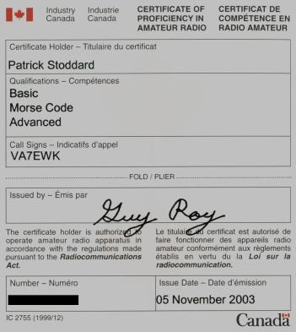
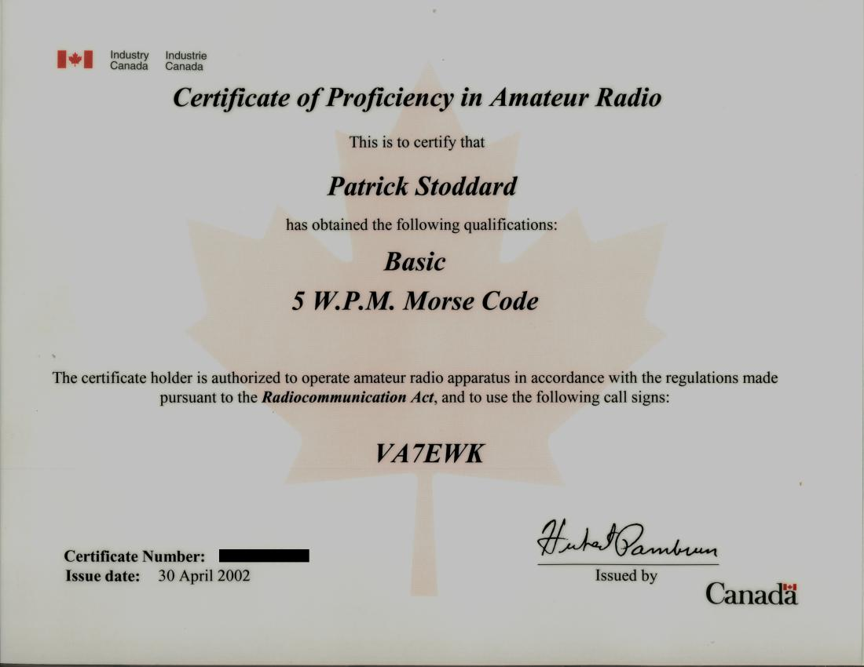
Regulations & Policies
Lesson One
1-2) License Fee, Term, Posting Requirements, Change of Address

Slide 7
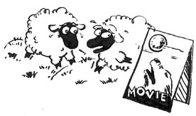

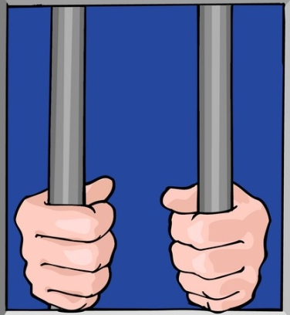
Regulations & Policies
Lesson One
1-3) License Suspension or Revocation, Powers of radio Inspectors, Offences & Punishments
If an amateur pretends there is an emergency and transmits the word "MAYDAY," this is called false or deceptive signals
A person found guilty of transmitting a false or fraudulent distress signal, or interfering with or obstructing any radio communication without lawful cause, may be liable to a penalty of: a fine, not exceeding $5,000, or a prison term of one year, or both
The Minister may suspend or revoke a radio authorization WITHOUT NOTICE where the holder has failed to comply with a request to pay fees or interest due
=

Slide 8
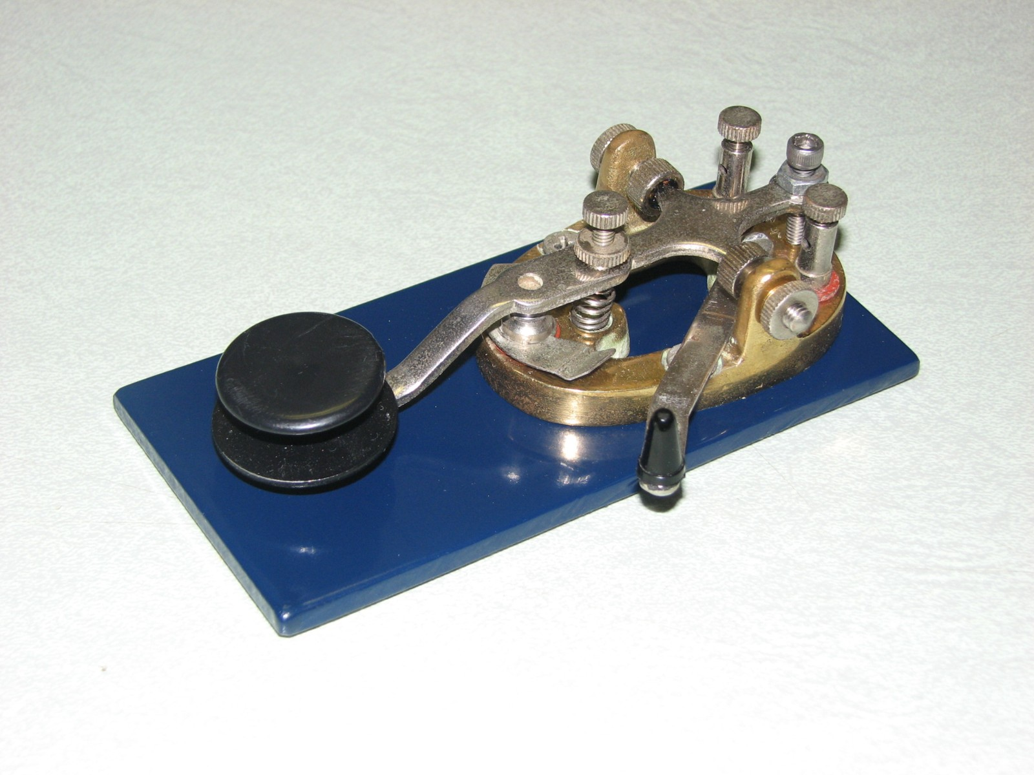
Regulations & Policies
Lesson One
1-4) Operators Certificates, Applicability, Eligibility, Equivalents, Reciprocal Recognition
There is no age limit on who can hold an Amateur Radio Operator Certificate with Basic Qualification
A Basic Examination must be passed before an Amateur Radio Operator Certificate is issued
The holder of an Amateur Digital Radio Operator's Certificate has equivalency for the Basic and Advanced qualifications
After an Amateur Radio Operator Certificate with Basic qualifications is issued, the holder may be examined for additional qualifications in any order
One Morse code qualification is available for the Amateur Radio Operator Certificate. It is: 5 w.p.m.
The holder of an Amateur Radio Operator Certificate with Basic Qualification is authorized to operate a station authorized in the amateur service

Slide 9

Regulations & Policies
Lesson One
1-5) Operation, Repair & Maintenance of Radio Apparatus On Behalf of Other Persons
Radio apparatus may be installed, placed in operation, repaired or maintained by the
holder of an Amateur Radio Operator Certificate with Advanced Qualification on behalf of another person if the other person is the holder of a radio authorization to operate in the amateur radio service
The holder of an Amateur Radio Operator Certificate may build transmitting equipment for use in the amateur radio service provided that person has the Advanced qualification
Where a friend is not the holder of any type of radio operator certificate, you, as a holder of an Amateur Radio Operator Certificate with Basic Qualification may on behalf of your friend NOT install, place in operation, modify, repair, maintain, or permit the operation of the radio apparatus
A radio amateur with Basic and 5 w.p.m. Morse qualifications may install an amateur
station for another person only if the other person is the holder of a valid Amateur Radio Operator Certificate

Slide 10
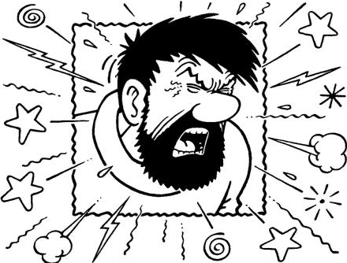
Regulations & Policies
Lesson One
1-6) Operation of Radio Apparatus, Terms of License, Applicable Standards, Exempt Apparatus
An amateur station with a maximum input to the final stage of 2 watts must be licensed at all locations
An amateur station may be used to communicate with similarly licensed stations
A radio amateur may not transmit superfluous* signals
A radio amateur should refrain from transmitting profane or obscene language
A radio amateur may not operate, or permit to be operated, a radio apparatus which he knows is not performing to the Radiocommunication Regulations
No person shall possess or operate any device, for the purpose of amplifying the output power of a license-exempt radio apparatus
A person may operate or permit the operation of radio apparatus only where the apparatus is maintained to the Radiocommunication Regulations tolerances
* | Unnecessary or needless Being more than is sufficient or required; excessive.

Slide 11
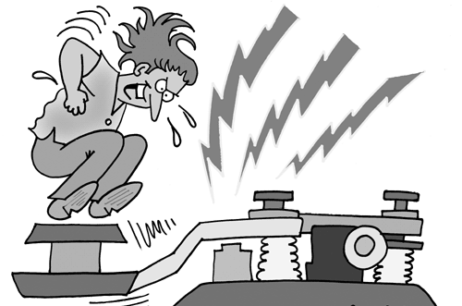
Regulations & Policies
Lesson One
1-7) Content Restrictions – Non-Superfluous, Profanity, Secret Code, Music, Non-Commercial
Business planning CANNOT be discussed on an amateur club net
A radio amateur is Never allowed to broadcast information to the general Public
False or deceptive amateur signals or communications may Never be transmitted
An amateur station in two-way communication may Never transmit a message in a secret code in order to obscure the meaning of the communication

Slide 12
Regulations & Policies
Lesson One
1-8) Installation and Operating Restrictions – Number of stations, Repeaters, Home-Built, Club Stations
The holder of an Amateur Radio Operator Certificate operate an amateur radio station anywhere in Canada.
A Beacon station may transmit Only one-way communications.
In order to install any radio apparatus to be used specifically for receiving and
automatically re-transmitting radiotelephone communications within the same frequency band, a radio amateur must hold an Amateur Radio with a minimum of Basic and Advanced qualifications
In order to install any radio apparatus to be used specifically for an amateur radio club station the radio amateur must hold an Amateur Radio Operator Certificate with a minimum of the following qualifications: Basic and Advanced
In order to install or operate a transmitter or RF amplifier that is not commercially manufactured for use in the amateur service, a radio amateur must hold an Amateur Operator's Certificate, with a minimum of Basic and Advanced

Slide 13
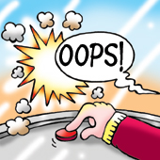
Regulations & Policies
Lesson One
1-9) Participation in Communications by Visitors, Use of Station by Others
Both the control operator and the station licensee are responsible for the proper operation of an amateur station
The owner of an amateur station may permit any person to operate the station under the supervision and in the presence of the holder of the amateur operator certificate.

Slide 14
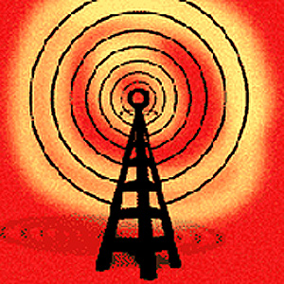
Regulations & Policies
Lesson One
1-10) Interference, Determination, Protection from Interference
You may Never deliberately interfere with another station's communications
If the regulations say that the amateur service is a secondary user of a frequency band, and another service is a primary user, Amateurs are allowed to use the frequency band only if they do not cause interference to primary users
What rule applies if two amateur stations want to use the same frequency? Both station operators have an equal right to operate on the frequency
Where interference to the reception of radiocommunications is caused by the operation of an amateur station the Minister may require that the necessary steps for the prevention of the interference be taken by the radio amateur
Radio amateur operations are not protected from interference caused by another service operating in the following frequency bands: 902 to 928 MHz

Slide 15

Regulations & Policies
Lesson One
1-11) Emergency Communications (Real or Simulated), Communications with Non-Amateur Stations
Amateur radio stations may communicate with any station involved in a real or simulated emergency
In the amateur radio service, business communications are not permitted under any circumstance
If you hear an unanswered distress signal on an amateur band where you do not have privileges to communicate you should offer assistance
In the amateur radio service it is permissible to broadcast radio communications required for the immediate safety of life of individuals or the immediate protection of property
An amateur radio station in distress may use any means of radiocommunication

Slide 16
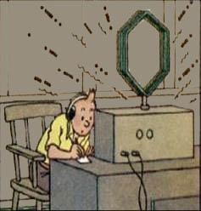
Regulations & Policies
Lesson One
1-11) Emergency Communications (Real or Simulated), Communications with Non-Amateur Stations
During a disaster, when may an amateur station make transmissions necessary to meet essential communication needs and assist relief operations? When normal communication systems are overloaded, damaged or disrupted
There are no power limitations during an emergency
During a disaster most communications are handled by nets using predetermined frequencies in amateur bands. Operators not directly involved with disaster communications are requested to avoid making unnecessary transmissions on or near frequencies being used for disaster communications.
Messages from recognized public service agencies may be handled by amateur radio stations during peace time and civil emergencies and exercises
It is permissible to interfere with the working of another station if
your station is directly involved with a distress situation

Slide 17

Regulations & Policies
Lesson One
1-12) Non-remuneration, Privacy of Communications
No payment of any kind is allowed for third-party messages sent by an Amateur Station
Radiocommunication transmitted by stations other than a broadcasting station may be divulged or used if it is transmitted by an amateur station
The operator of an amateur station shall not demand or accept remuneration in any form in respect of a radiocommunication that the person transmits or receives.

Slide 18
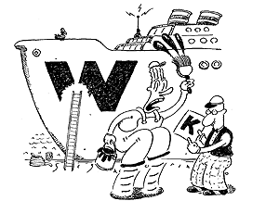
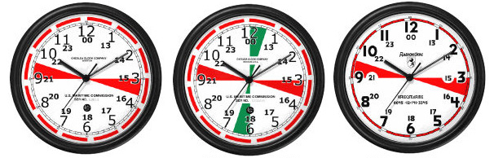
Regulations & Policies
Lesson One
1-13) Station Identification, Callsigns, Prefixes
An amateur station must identify At least every thirty minutes, and at the beginning and at the end of a contact
You must transmit your call sign to identify your amateur station.
When may an amateur transmit unidentified communications? Never, except to control a model craft
What language may you use when identifying your station? English or French
The call sign of a Canadian amateur radio station would normally start with the letters: VA, VE, VO or VY

Slide 19
1-13) Station Identification, Call signs, Prefixes
Regulations & Policies
Lesson One
Call Sign Prefix | Province or Territory
CY0 | Sable Island (Nova Scotia)
CY9 | St-Paul Island (Nova Scotia)
VA1, VE1 | Nova Scotia
VA2, VE2 | Quebec
VA3, VE3 | Ontario
VA4, VE4 | Manitoba
VA5, VE5 | Saskatchewan
VA6, VE6 | Alberta
VA7, VE7 | British Columbia
VE8 | North West Territories
VE9 | New Brunswick
VO1 | Newfoundland
VO2 | Labrador
VY0 | Nunavut
VY1 | Yukon
VY2 | Prince Edward Island

Slide 20
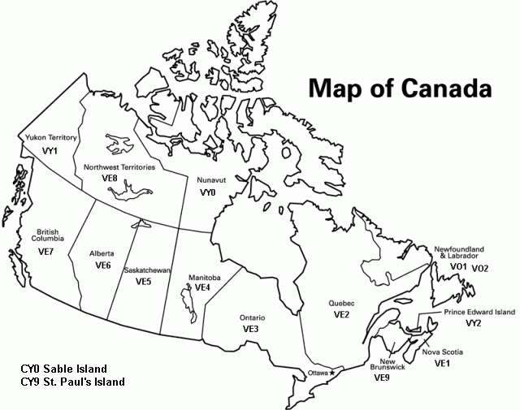
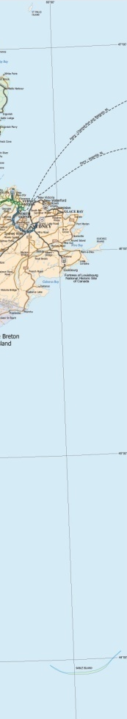
St. Paul’s and Sable Island are protected under the Canada Shipping Act, which means that permission must be obtained from the Canadian Coast Guard to visit the islands, hence why they have special call signs.

Slide 21
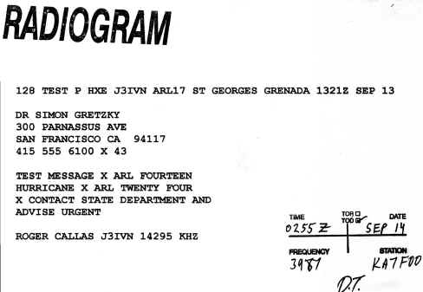
Regulations & Policies
Lesson One
1-14) Foreign Amateur Operation in Canada, Banned Countries, Third-Party Messages
If a non-amateur friend is using your station to talk to someone in Canada, and a foreign station breaks in to talk to your friend, what should you do? Have your friend wait until you find out if Canada has a third-party agreement with the foreign station's Government
If you let an unqualified third party use your amateur station, what must you do at your station's control point? You must continuously monitor and supervise the third party's participation
A person operating a Canadian amateur station is forbidden to communicate with amateur stations of another country when that country has notified the International Telecommunication Union that it objects to such communications
Third-party traffic is a message sent to a non- amateur via an amateur station

Slide 22
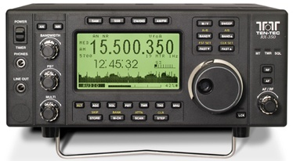
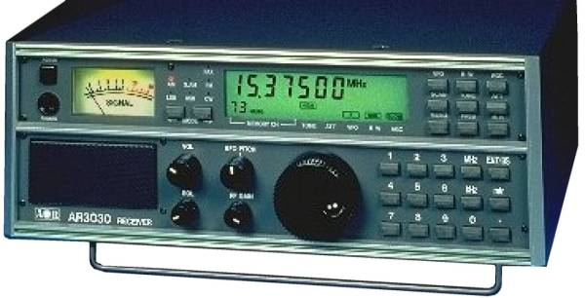
Regulations & Policies
Lesson One
1-15) Frequency Bands & Qualification Requirements
If you are the control operator at the station of another amateur who has additional qualifications to yours, what operating privileges are you allowed? Only the privileges allowed by your qualifications.
In addition to passing the Basic written examination, what must you do before you are allowed to use amateur frequencies below 30 MHz? Advanced test or attain a mark of 80% on the Basic exam.
The licensee of an amateur station may operate radio controlled models on all frequencies above 30 MHz

Slide 23
Regulations & Policies
Lesson One
1-15) Frequency Bands & Qualification Requirements
In Canada, the 160 meter amateur band corresponds in frequency to: 1.8 to 2.0 MHz
In Canada, the 75/80 meter amateur band corresponds in frequency to:3.5 to 4.0 MHz
In Canada, the 40 meter amateur band corresponds in frequency to: 7.0 to 7.3 MHz
In Canada, the 20 meter amateur band corresponds in frequency to:14.000 to 14.350 MHz
In Canada, the 15 meter amateur band corresponds in frequency to:21.000 to 21.450 MHz
In Canada, the 10 meter amateur band corresponds in frequency to:28.000 to 29.700 MHz

Slide 24
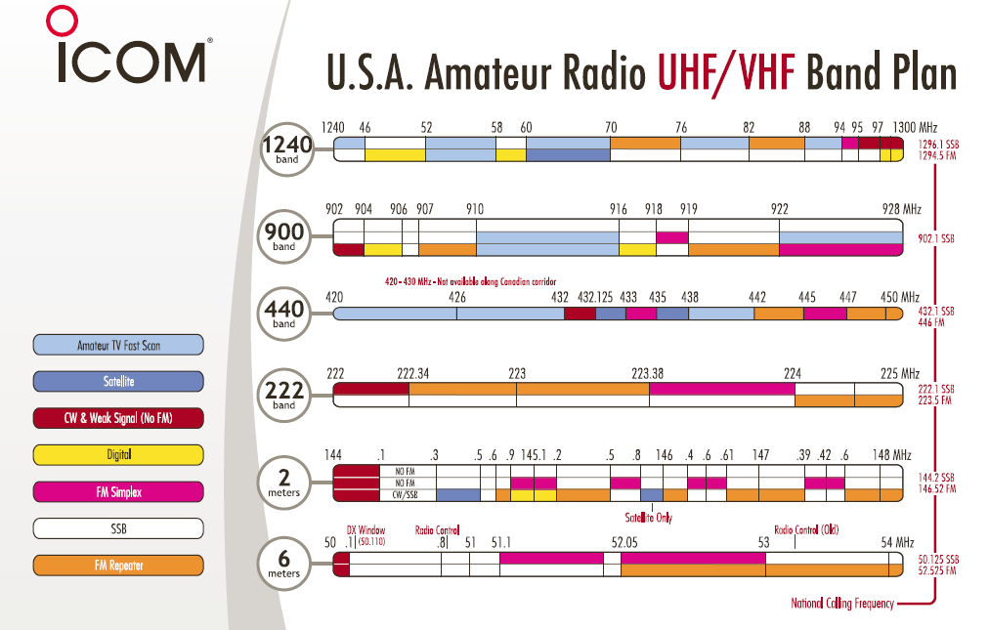
Regulations & Policies
Lesson One
1-15) Frequency Bands & Qualification Requirements

Slide 25
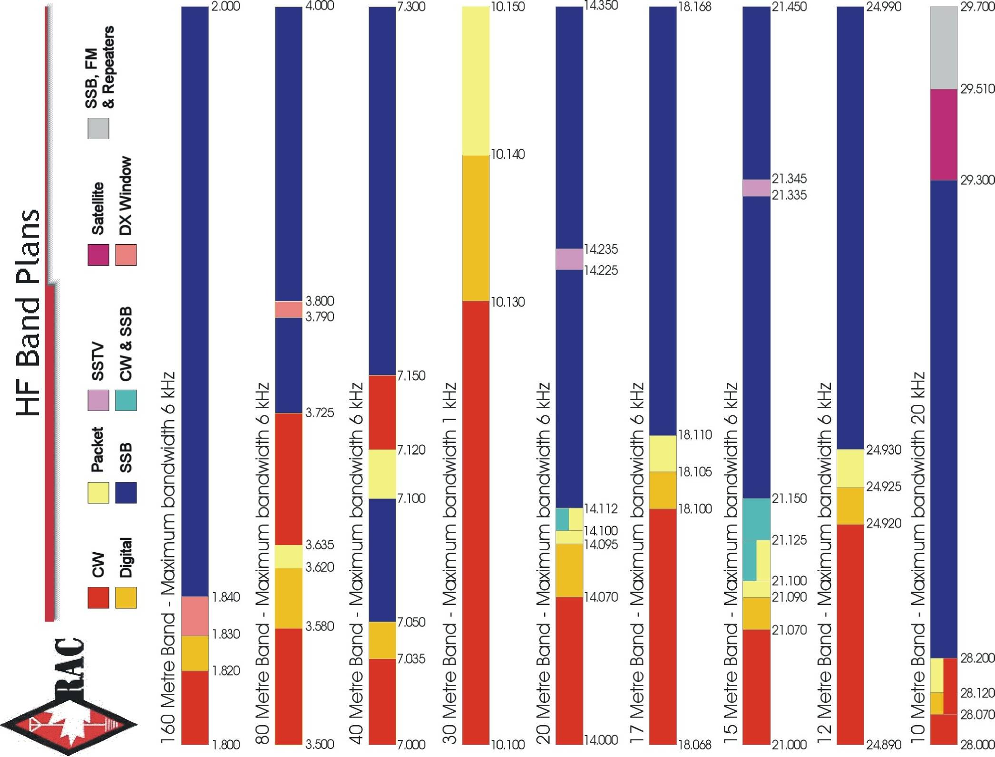
Regulations & Policies
Lesson One
1-15) Frequency Bands & Qualification Requirements

Slide 26
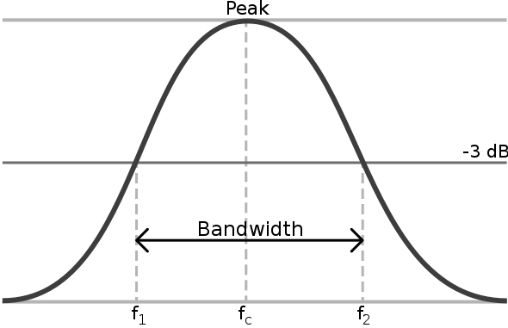
Regulations & Policies
Lesson One
1-16) Maximum Bandwidth by Frequency Bands
The maximum authorized bandwidth within the frequency range of 50 to 148 MHz
shall not exceed 10 times that of a CW emission 30 kHz
The maximum bandwidth of an amateur station's transmission allowed in the band 28 to
29.7 MHz is: 20 kHz
Only one band of amateur frequencies has a maximum allowed bandwidth of less than 6
kHz. That band is: 10.1 to 10.15 MHz
Single sideband is not permitted in the band: 10.1 to 10.15 MHz
The bandwidth of an amateur station shall be determined by measuring the frequency
band occupied by that signal at a level of 26 dB below the maximum amplitude of that
Signal.

Slide 27
Regulations & Policies
Lesson One
1-17) Restrictions on Capacity & Power Output by Qualifications
What amount of transmitter power must radio amateurs use at all times? The minimum
legal power necessary to communicate
What is the most FM transmitter power a holder of only Basic Qualification may use on
147 MHz? 250 W DC input
At what point in your station is transceiver power measured? At the antenna terminals of
the transmitter or amplifier
What is the maximum transmitting power an amateur station may use for SSB operation on
7055 kHz, if the operator has Basic+ qualifications: 560 watts PEP output.
The DC power input to the anode or collector circuit of the final RF stage of a transmitter
used by a holder of an Amateur Radio Operator Certificate with Advanced
Qualification shall not exceed 1000 watts

Slide 28
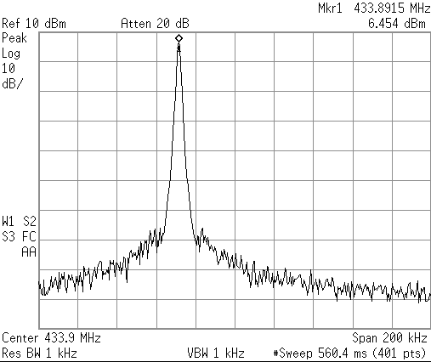
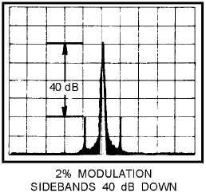
Regulations & Policies
Lesson One
1-18) Unmodulated Carriers, Re-Transmission
What kind of amateur station automatically retransmits the signals of other stations?
Repeater station
An unmodulated carrier may be transmitted only for brief tests on frequencies below
30 MHz
Radiotelephone signals in a frequency band below 29.5 MHz cannot be
automatically retransmitted, unless these signals are received from a station operated by
a person qualified to transmit on frequencies below the above frequency

Slide 29
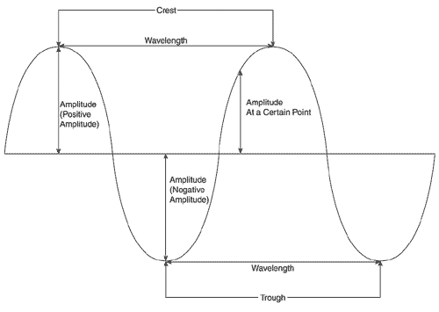
Regulations & Policies
Lesson One
1-19) Amplitude Modulation, Frequency Stability, Measurements
When operating on frequencies below 148 MHz the frequency stability must be
comparable to crystal control
An amateur station using radiotelephony must install a device for indicating or preventing
overmodulation
The maximum percentage of modulation permitted in the use of radiotelephony by an
amateur station is 100 percent
All amateur stations, regardless of the mode of transmission used, must be equipped with
a reliable means of determining the operating radio frequency

Slide 30

Regulations & Policies
Lesson One
1-20) International Telecommunication Union (ITU) Radio Regulations,
Applicability
What type of messages may be transmitted to an amateur station in a foreign country?
Messages of a technical nature or personal remarks of relative unimportance
The operator of an amateur station shall ensure that communications are limited to
messages of a technical or personal nature
In addition to complying with the Act and Radiocommunication Regulations, Canadian radio
amateurs must also comply with the regulations of the International Telecommunication
Union
In which International Telecommunication Union Region is Canada? Region 2

Slide 31
Regulations & Policies
Lesson One
1-21) Operation Outside Canada, ITU Regions, Reciprocal Privileges, International Licences
A Canadian radio amateur, operating his station 7 kilometers (4 miles) offshore from the
coast of Florida, is subject to which frequency band limits? Those applicable to US radio
amateurs
Australia, Japan, and Southeast Asia are in which ITU Region? Region 3
Canada is located in ITU Region: Region 2

Slide 32
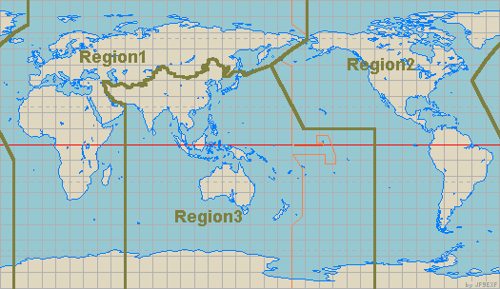
IARU Regions

Slide 33
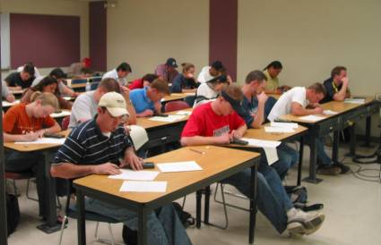
Regulations & Policies
Lesson One
1-22) Examinations, Department’s Fees, Delegated Examinations, Fees, Disabled Accommodation
The fee for taking examinations for amateur radio operator certificates by an accredited
volunteer examiner is to be negotiated between examiner and candidate
The fee for taking amateur radio certificate examinations at an Industry Canada office is $20
per qualification

Slide 34
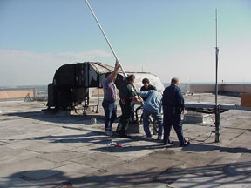
Regulations & Policies
Lesson One
1-23) Antenna Structure Approval, Neighbour and Land-Use Authority Consultation
Before erecting an antenna structure for which community concerns could be raised a
radio amateur must consult with the land-use authority, and possibly the neighbors

Slide 35
Regulations & Policies
Lesson One
1-24) Radiofrequency Electromagnetic Filed Limits
What organization has published safety guidelines for the maximum limits of RF energy
near the human body? Health Canada
What is the purpose of the Safety Code 6? It gives RF exposure limits for the
human body
According to Safety Code 6, what frequencies cause us the greatest risk from RF
energy? 30 to 300 MHz
Why is the limit of exposure to RF the lowest in the frequency range of 30 MHz to 300
MHz, according to Safety Code 6? The human body absorbs RF energy the
most in this range

Slide 36
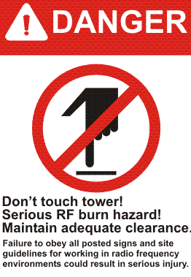
Regulations & Policies
Lesson One
1-24) Radiofrequency Electromagnetic Field Limits
The permissible exposure levels of RF fields increases as frequency is increased
above 300 MHz

Slide 37
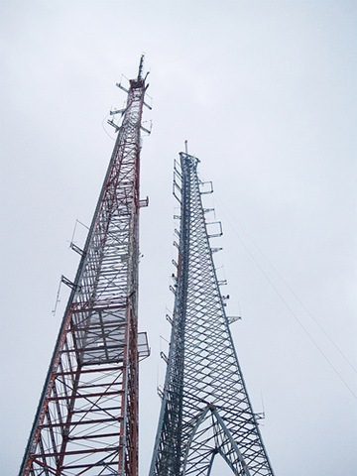
Regulations & Policies
Lesson One
1-25) Criteria for Resolution of Radio Frequency Interference Complaints
In the event of interference to a neighbor's FM receiver and stereo system, if the field
strength of the amateur station signal is below 1.83 volts per meter, it will be deemed that
the affected equipment's lack of immunity is the cause
Which of the following is defined as "any device, machinery or equipment, other than radio
apparatus, the use or functioning of which is, or can be, adversely affected by
radio communication emissions"? radio-sensitive equipment
Which of the following types of equipment is NOT included in the list of field strength criteria
for resolution of immunity complaints? broadcast transmitters

