Slide 1
CHAPTER 16
SAFETY

Slide 2
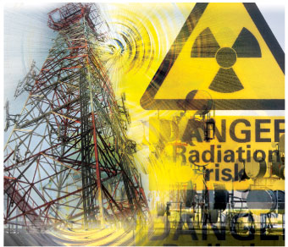
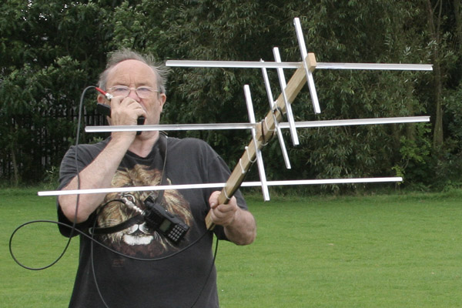
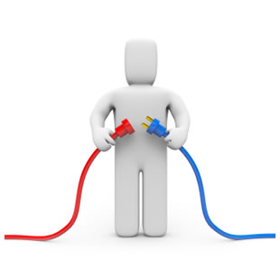
Safety

Slide 3
Safety
Building and operating a “ham” radio station is a perfectly safe pastime
However, carelessness can lead to severe injury, burns, or even death by electrocution
Antenna Safety – Look Up and Live!

Slide 4
Safety
Assume that all overhead power lines are energized and dangerous. They are often not covered! This sometimes includes the service drop, which typically runs from the power pole to your home or shack.
Watch out for power lines which may be hidden by trees and buildings
Plan the work and work the plan. Before you put up or take down an antenna, assess the job. Discuss the project’s activities with your helpers and agree on specific assignments. Ask yourself, “At any time can arms, legs, head, the antenna, wires or tools come in contact with power lines?”
Use a safety spotter. Nobody can do the work alone and assess safety distances. A safety spotter’s only job is to keep people and equipment safely away from power lines
Remember the 10-foot rule. Keep all equipment, tools, your antenna, guy wire and tower at least 10 feet away from power lines.

Slide 5
Safety
Never use metal ladders or long-handled metal tools when working near power lines
Make sure the antenna cannot be rotated into power lines or that it cannot fall into a power line if the guy wires fail and the tower falls
Use non-conductive guy ropes
Have a solid earth ground for your antenna and operating equipment. This helps reduce the risk of electrical shock and also provides a low-impedance path to ground for stray RF.

Slide 6
Safety
Outdoor antennas should be grounded with an approved lighting arresting device. Local codes may apply.
The radio should also be grounded to an earth ground to help protect both the radio and its user
Antenna mast, cable, and guy wires are all excellent conductors of electrical current
If the tower assembly starts to drop... get away from it and let it fall
DO NOT use hot water pipes or gas lines as a ground source
DO NOT place antennas where people or animals are likely to run into or encounter them
Don’t be afraid to ask questions or ask for assistance – most other amateurs will be very happy to assist you

Slide 7
Safety Code 6
The regulations and guidelines covering the subject of RF Safety are published by Health Canada in the federal government, in a document we call "Safety Code 6“
The document describes the limits of human exposure to radiofrequency electromagnetic fields in the Frequency Range from 3 kHz to 300 GHz
Amateur radio stations are technically required to comply
All but our most-high-powered transmissions do comply in most well-designed stations
Some very high-powered transmissions require extra care and attention to antenna placement and protection

Slide 8
Safety Code 6
RF energy has thermal effects (i.e., it can cause body heating) if the power density is high enough
The thermal effects of RF energy can include blindness and sterility, among other health problems
Effect varies with power and with frequency

Slide 9
Installing Antennas – Good Practices
At least two people to do the job. Three is better.
Equipment
Safety Belt
Safety Rope / use of it while climbing, no mould inside (twist open to inspect it), proper length
Tool Pouch (roomy, not packed full)
Tools carefully selected for the task (how many times do you want to climb the tower?!)
Clothing
Close fitting, not sloppy, but not too tight
Gloves (for protection and warmth)
NO Sneakers; use hard soled boots with a good fit

Slide 10
Safety Belt
For your safety it is of the utmost importance that you borrow or buy a safety belt
“Safety belt” is a generic term that describes a two-part device:
First a heavy leather belt, at least 5 cm (2”) wide or 2", which is long enough to loosely encircle the perimeter of the tower
Second, an independent security harness system, at least 10 cm (4”) wide with a waist belt and a seat harness. This security harness must be attachable with locking steel hooks to the first belt (the one you put around the tower.)
The above is a minimum safety requirement
Ideally, a full fall-protection safety body harness with chest straps and back-mounted snag hook should be used with appropriate hardware, if available

Slide 11
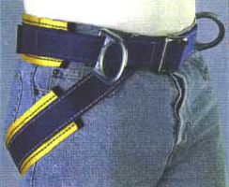
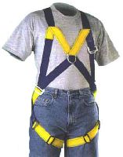
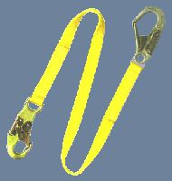
Safety Belt

Slide 12
What is a Gin Pole?
A gin pole is a tower / antenna raising fixture, a pole with tip-mounted pulley on one end and a fixing clamp on the other end
It provides safety by giving the installers improved heavy lifting ability from the ground
A gin pole consists of 3 basic parts:
a pulley assembly to provide mechanical advantage when lifting,
a pole to gain height needed for the lift, and
the clamp assembly to attach everything to the tower
Typically, the ground person does the heavy lifting while the tower person above guides and fastens the tower and antenna components together
Proper use of a gin pole provides a controllable and safe method to erect and maintain a tower and antenna assembly, use it!

Slide 13
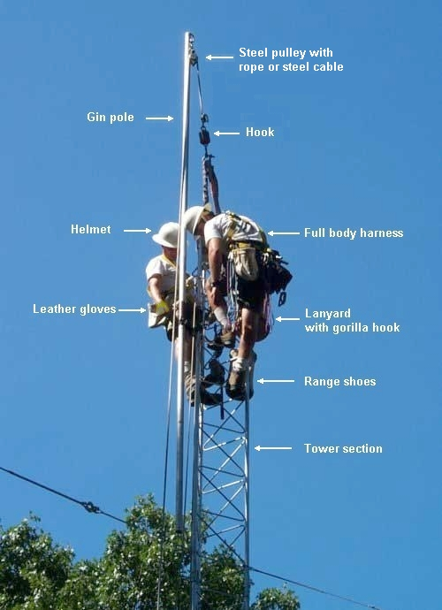
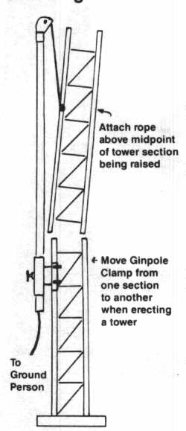
What is a Gin Pole?

