Slide 1
CHAPTER 15
Radio Frequency Interference

Slide 2


Interference & Suppression Page 59
Front-End Overload, Cross-Modulation
What is meant by receiver overload? Interference caused by strong signals from a nearby transmitter
What is one way to tell if radio frequency interference to a receiver is caused by front-end overload? If the interference is about the same no matter what frequency is used for the transmitter
If a neighbour reports television interference whenever you transmit, no matter what band you use, what is probably the cause of the interference? Receiver overload
What type of filter should be connected to a TV receiver as the first step in trying to prevent RF overload from an amateur HF station transmission? High-pass
When the signal from a transmitter overloads the audio stages of a broadcast receiver, the transmitted signal: can appear wherever the receiver is tuned.

Slide 3
Front-End Overload, Cross-Modulation Con’t
Cross-modulation of a broadcast receiver by a nearby transmitter would be noticed in the receiver as: the undesired signal in the background of the desired signal
What is cross-modulation interference? Modulation from an unwanted signal is heard in addition to the desired signal
What is the term used to refer to the condition where the signals from a very strong station are superimposed on other signals being received? Cross-modulation interference
What is the result of cross-modulation? The modulation of an unwanted signal is heard on the desired signal
If a television receiver suffers from cross-modulation when a nearby amateur transmitter is operating at 14 MHz, which of the following cures might be effective? A high pass filter attached to the antenna input of the television
How can cross-modulation be reduced? By installing a suitable filter at the receiver

Slide 4
Audio Rectification etc. Page 61
What sound is heard from a public address system if audio rectification of a nearby single-sideband phone transmission occurs? Distorted speech from the transmitter's signals
What sound is heard from a public address system if audio rectification of a nearby CW transmission occurs? On-and-off humming or clicking
How can you minimize the possibility of audio rectification of your transmitter's signals? By ensuring that all station equipment is properly grounded
An amateur transmitter is being heard across the entire dial of a broadcast receiver. The receiver is most probably suffering from: cross-modulation or audio rectification in the receiver
Cross-modulation is usually caused by: rectification of strong signals

Slide 5
Audio Rectification etc. Con’t
What devices would you install to reduce or eliminate audio-frequency interference to home entertainment systems? Bypass capacitors
Stereo speaker leads often act as antennas to pick up RF signals. What is one method you can use to minimize this effect? Shorten the leads
Stereo amplifiers often have long leads which pick up transmitted signals because they act as:
receiving antennas

Slide 6



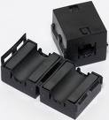


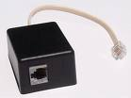
Audio Rectification etc. Con’t
What device can be used to minimize the effect of RF pickup by audio wires connected to stereo speakers, intercom amplifiers, telephones, etc.? Ferrite core
One method of preventing RF from entering a stereo set through the speaker leads is to wrap each of the speaker leads around a: ferrite core
What should be done if a properly operating amateur station is the cause of interference to a nearby telephone? Ask the telephone company to install RFI filters

Slide 7
Intermodulation & Key Clicks Page 60 / 61
If someone tells you that signals from your hand-held transceiver are interfering with other signals on a frequency near yours, what may be the cause? Your hand-held may be transmitting spurious emissions
If your transmitter sends signals outside the band where it is transmitting, what is this called? Spurious emissions
What problem may occur if your transmitter is operated without the cover and other shielding in place? It may transmit spurious emissions
A parasitic oscillation: is an unwanted signal developed in a transmitter

Slide 8
Intermodulation & Key Clicks Con’t
Parasitic oscillations in the RF power amplifier stage of a transmitter may be found: at high or low frequencies
Transmitter RF amplifiers can generate parasitic oscillations: on either side of the transmitter frequency
In Morse code transmission, local RF interference (key-clicks) is produced by: the making and breaking of the circuit at the Morse key
Key-clicks, heard from a Morse code transmitter at a distant receiver, are the result of: too sharp rise and decay times of the carrier
How can you prevent key-clicks? By using a key-click filter
In a Morse code transmission, local RF interference (key-clicks) is produced by: Sparking at the key contacts
Key-clicks can be suppressed by: inserting a choke and a capacitor at the key

Slide 9
Harmonics, Splatter etc. Page 61
If a neighbour reports television interference on one or two channels only when you transmit on 15 metres, what is probably the cause of the interference? Harmonic radiation from your transmitter
What is meant by harmonic radiation? Unwanted signals at frequencies which are multiples of the fundamental (chosen) frequency
Why is harmonic radiation from an amateur station not wanted? It may cause interference to other stations and may result in out-of-band signals
What type of interference may come from a multi-band antenna connected to a poorly tuned transmitter? Harmonic radiation
If you are told your station was heard on 21,375 kHz, but at the time you were operating on 7,125 kHz, what is one reason this could happen? Your transmitter was radiating harmonic signals
Your amateur radio transmitter appears to be creating interference to the television on channel 3 (60-66 MHz) when you are transmitting on the 15 metre band. Other channels are not affected. The most likely cause is: harmonic radiation from the transmitter

Slide 10
Harmonics, Splatter etc. Con’t
One possible cause of TV interference by harmonics from an SSB transmitter is from "flat topping" - driving the final amplifier into non-linear operation. The most appropriate remedy for this is: reduce microphone gain
In a transmitter, excessive harmonics are produced by: overdriven stages
An interfering signal from a transmitter is found to have a frequency of 57 MHz (TV Channel 2 is 54 - 60 MHz). This signal could be the: transmission of the second harmonic of a 10 metre transmission
Harmonics may be produced in the RF power amplifier of a transmitter if: excessive drive signal is applied to it
What causes splatter interference? Over-modulation of a transmitter

Slide 11
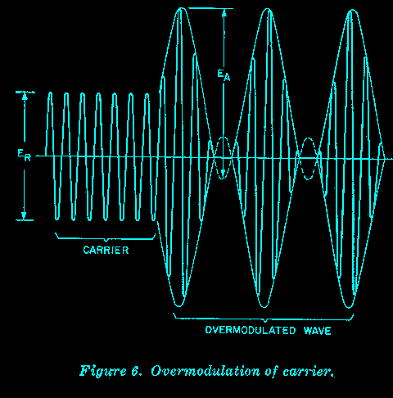


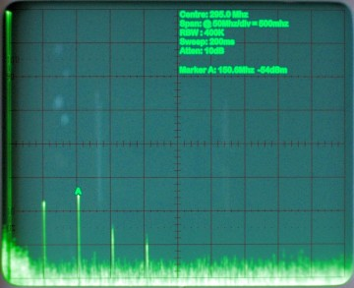

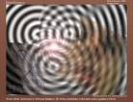

Slide 12
Use of Filters, etc. Page 62
What type of filter might be connected to an amateur HF transmitter to cut down on harmonic radiation? A low pass filter
In order to reduce the harmonic output of a high frequency (HF) transmitter, which of the following filters should be installed at the transmitter? Low pass
To reduce harmonic output from a transmitter, you would put a ____ in the transmission line as close to the transmitter as possible: A low pass filter
Why do modern HF transmitters have a built-in low pass filter in their RF output circuits? To reduce harmonic radiation
What should be the impedance of a low pass filter as compared to the impedance of the transmission line into which it is inserted? About the same
A low pass filter suitable for a high frequency transmitter would:
attenuate frequencies above 30 MHz
A high pass filter would normally be fitted: at the antenna terminals of the TV receiver

Slide 13
Use of Filters, etc. Page 62
When considering filters remember
High pass filters go on the receiver end
Low pass filters go on the transmitter

Slide 14


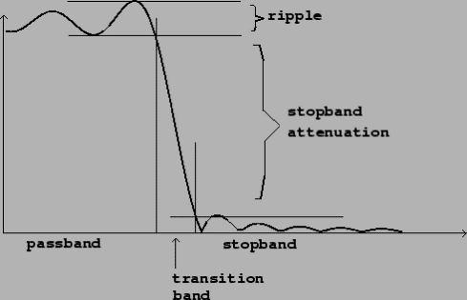
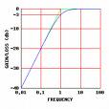
Use of Filters, etc. Con’t
What circuit blocks RF energy above and below a certain limit? A band pass filter
A band pass filter will: allow only certain frequencies through
A band reject filter will: pass frequencies each side of a band

