Slide 1
CHAPTER 10
Power Supplies

Slide 2
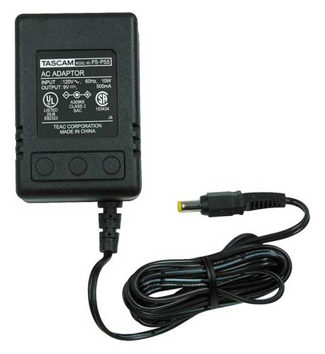
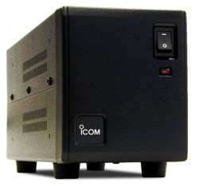
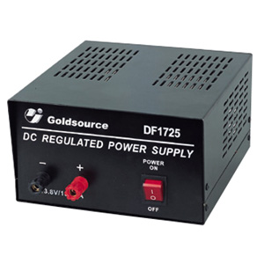
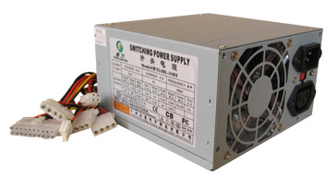
The Power Supply
A station’s power supply (sometimes known as a power supply unit or PSU) is a device or system that supplies electrical energy to an output load or group of loads
Stations may have one robust supply to feed all devices, or may have multiple power supplies.

Slide 3
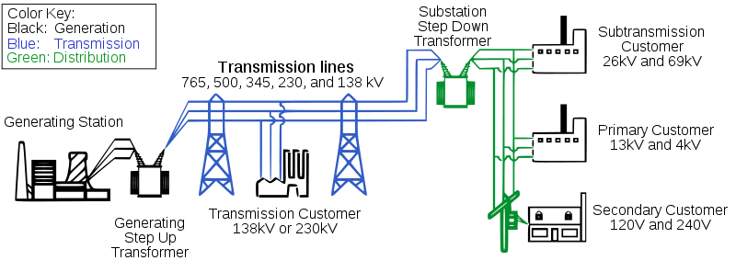
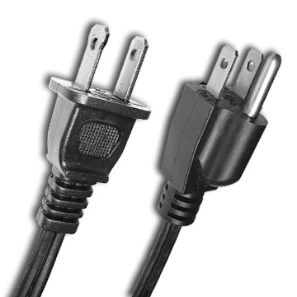
The Power Supply
Input voltage is
120 volt AC here
Station power supply
typically provides
13.8 VDC ± 5%

Slide 4
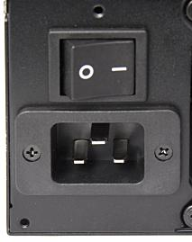
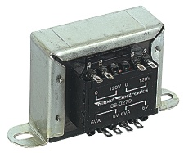
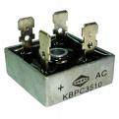
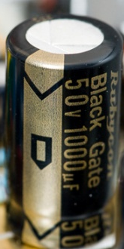
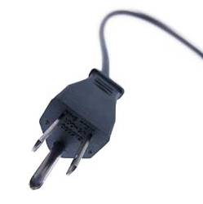
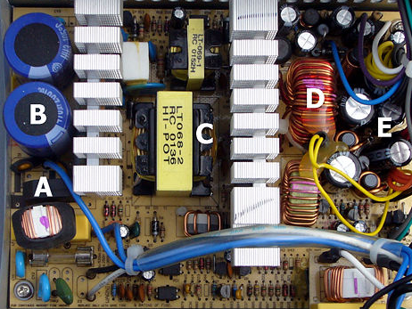
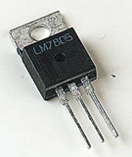
Regulated Power Supply
A - bridge rectifier
  B - input filter capacitors
  C - transformer
  D - output filter coil
  E - output filter capacitors

Slide 5
Transformer
A transformer is a device that transfers electrical energy from one circuit to another through a shared magnetic field
A changing current in the first circuit (the primary) creates a changing magnetic field
In turn, this magnetic field induces a changing voltage in the second circuit (the secondary)
By adding a load to the secondary circuit, one can make current flow in the transformer, thus transferring energy from one circuit to the other

Slide 6
Rectifier
A rectifier is an electrical device that converts alternating current to direct current, a process known as “rectification”
Rectifiers are used as components of power supplies and as detectors of radio signals
Rectifiers may be made of solid state diodes, vacuum tube diodes, mercury arc valves, or other components
A circuit which performs the opposite function (converting DC to AC) is known as an “inverter”

Slide 7
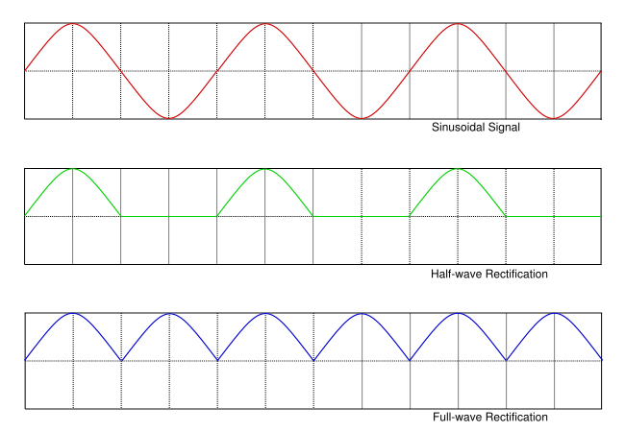
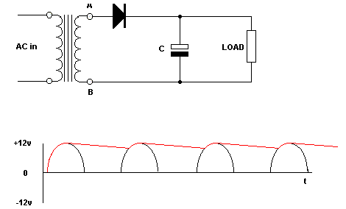
AC
DC

Slide 8
Filter
Electronic circuits which perform signal processing functions, specifically intended to remove unwanted signal components and/or enhance wanted ones
Low-pass filter - Low frequencies are passed, high frequencies are attenuated **
High-pass filter - High frequencies are passed, low frequencies are attenuated **
Band-pass filter - Only frequencies in a frequency band are passed
Band-stop filter - Only frequencies in a frequency band are attenuated **
** Attenuated or attenuation is the reduction in amplitude and intensity of a signal

Slide 9
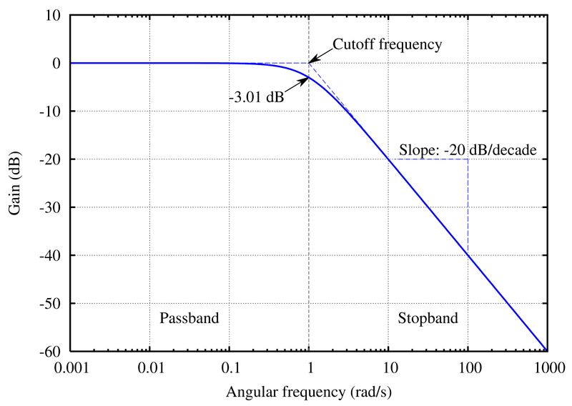
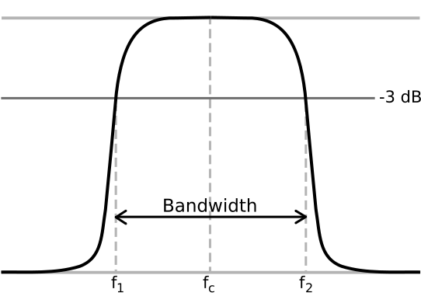
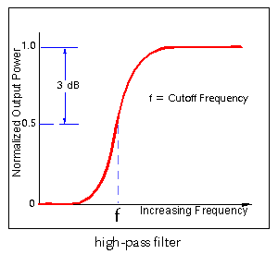
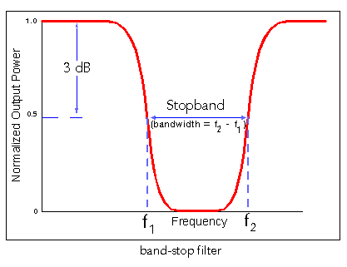
Filters
LOW PASS
BAND PASS
HIGH PASS
BAND STOP

Slide 10
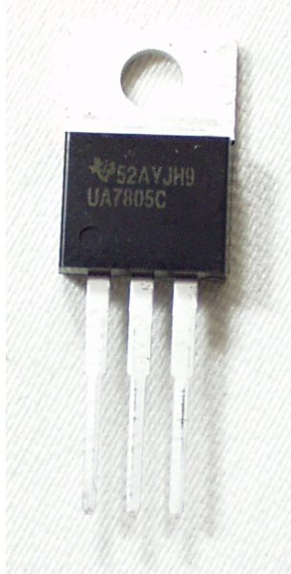
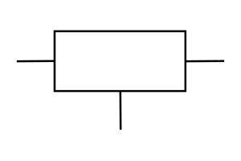
Regulator
A voltage regulator is an electrical regulator designed to automatically maintain a constant voltage level.
Voltage-Regulator-IEC-Symbol

Slide 11
Regulated Power Supply
Transfers electrical energy from one circuit to another
Converts alternating current to direct current
Remove unwanted signal components and/or enhance wanted ones
120 or 240 volt AC
Well-regulated lower DC voltage of 13.8v
Automatically maintain a constant voltage level

